Slide 1
Education at a Glance
OECD Indicators 2018
University of Latvia and Microsoft Innovation Centre
11th September 2018
Simon Normandeau
Notes:
Ladies and gentlemen, I don’t have an easy task. Within the next 30 minutes I will try to summarize nearly 500 pages of education statistics, 27 Indicators and over 50 thousand data points. As you will have understand this publication doesn’t really measure up to its title “at a glance”.

Slide 2

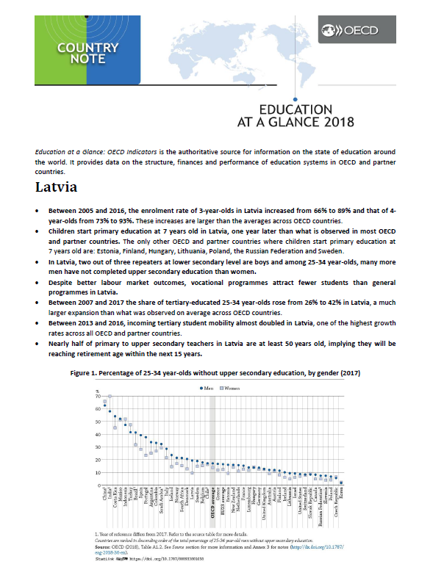
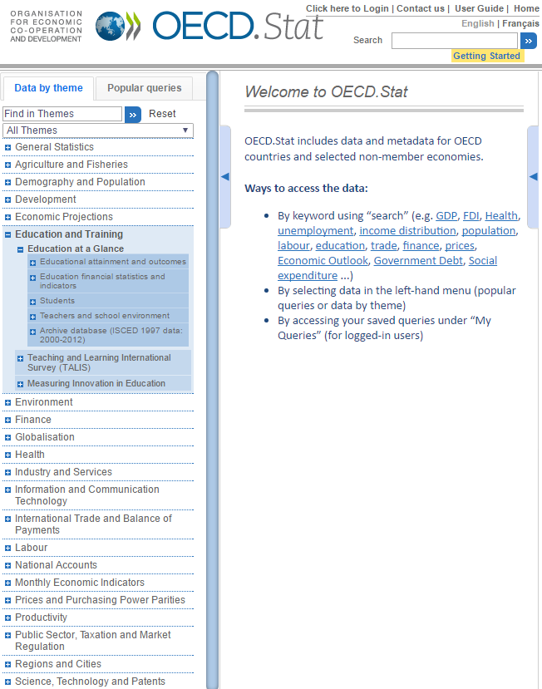
Education at a Glance, Country Note and OECD.Stat

Slide 3
Organisation of Education at a Glance (EAG)
Chapter A – The output of educational institutions and the impact of learning
Attainment rates, labour market outcomes of education (earnings, unemployment), social outcomes of education, educational mobility, adult education, NEETs, financial returns to education
Chapter B – Access to education, participation and progression
Enrolment rates, early childhood education, international student mobility, entrance and graduation rates
Chapter C – Financial resources invested in education
Chapter D – Teachers, the learning environment and the organisation of schools
Expenditure per students, expenditure as a share of GDP, share of private expenditure, decentralization of public expenditure, capital vs. current expenditure
Instruction time, teaching time, class sizes, student-teacher ratio, teachers’ salaries, teachers’ age and gender, school autonomy
The Education Sustainable Development Goal (SDG4)

Slide 4
OUTLINE
Equity
Early childhood education and care (ECEC)
General and vocational secondary education
Tertiary education
Finance
Teachers
Notes:
Today I would like to draw your attention on six topics that emerge from the report when looking at the education system in Latvia. The first one “equity” is the central topic of this edition and a key objective of education systems. I will then go through the main findings of the different levels of education from Early childhood education and care thought tertiary education. And finally, present some data on the financial resources invested in education and some data on teachers.

Slide 5

Equity
Notes:
Equity touches upon many different dimensions, it goes from the socioeconomic background to gender and migration.

Slide 6






Equity in Education at a Glance 2018
Gender
Immigrant status
Equity in the education
sustainable development goal
Parental education
Location
Notes:
Education at a Glance 2018 presents a wide array of indicators for which equity is analysed over a range of dimensions: gender equity, equity based on parental education (used as a proxy for socioeconomic parity), equity based on location (rural/urban, or sub-national differences when relevant) and equity by immigrant status (between native-born and foreign-born).

Slide 7
15-year-olds from rural areas and lower socio-economic status have lower performances in mathematics
SDG Fig1
Proportion of 15-year-olds achieving at least proficiency level 2 (PISA) in mathematics by gender,
socio-economic status (ESCS), and location parity indices (2015)
Notes:
At least level 2 = Students at least able to use basis formulae and algorithms – for example to compute the approximate price of an object in a different currency or to compare the total distance across two alternative routes.
A parity index equal to 1 means that the proficiency level in mathematics is equal in the two groups.
SDG related
Gender: OECD=0.99 / Latvia=1.04
Location: OECD: 0.84 / Latvia: 0.80
Economic, Social and Cultural Status (ESCS): OECD: 0.70 / Latvia: 0.74

Slide 8
15-year-olds from rural areas and lower socio-economic status have lower performances in mathematics
SDG Fig1
Proportion of 15-year-olds achieving at least proficiency level 2 (PISA) in mathematics by gender,
socio-economic status (ESCS), and location parity indices (2015)
Notes:
At least level 2 = Students at least able to use basis formulae and algorithms – for example to compute the approximate price of an object in a different currency or to compare the total distance across two alternative routes.
A parity index equal to 1 means that the proficiency level in mathematics is equal in the two groups.
SDG related
Gender: OECD=0.99 / Latvia=1.04
Location: OECD: 0.84 / Latvia: 0.80
Economic, Social and Cultural Status (ESCS): OECD: 0.70 / Latvia: 0.74

Slide 9
15-year-olds from rural areas and lower socio-economic status have lower performances in mathematics
SDG Fig1
Proportion of 15-year-olds achieving at least proficiency level 2 (PISA) in mathematics by gender,
socio-economic status (ESCS), and location parity indices (2015)
Notes:
At least level 2 = Students at least able to use basis formulae and algorithms – for example to compute the approximate price of an object in a different currency or to compare the total distance across two alternative routes.
A parity index equal to 1 means that the proficiency level in mathematics is equal in the two groups.
SDG related
Gender: OECD=0.99 / Latvia=1.04
Location: OECD: 0.84 / Latvia: 0.80
Economic, Social and Cultural Status (ESCS): OECD: 0.70 / Latvia: 0.74

Slide 10
Gender

Slide 11
Over 2/3 of repeaters in lower secondary schools are boys…
Figure B1.2
Share of boys among repeaters in lower secondary education (2016)

Slide 12
The percentage of young men with low education is twice that of young women in Latvia…
Figure A1.1
Percentage of 25-34 year-olds without upper secondary education, by gender (2017)
Notes:
Latvia: W10 M19 = Gap 10 pp
OECD: W12 M17 = Gap 5 pp

Slide 13
…but Latvia has a better gender equity than average for earnings of tertiary-educated workers
Figure A4.1
Women’s earnings as a percentage of men’s earnings
for full-time workers with tertiary education (2016)
Notes:
Women earn 80% of men salary – or if you want 20% less than men – a smaller gap compared to the OECD average
Latvia: 80
OECD: 74

Slide 14
Migrants

Slide 15
About 30% of native and foreign-born adults are tertiary educated…
Figure A1.3
Percentage of tertiary-educated native- and foreign-born 25-64 year-olds, by age at arrival in the country (2017)
Foreign-born adults
The percentage in parentheses represents the share of foreign-born adults among 25-64 year-olds.
Notes:
Latvia:
Native-born adults = 34
Arrive din the country by the age of 15 = 34
Arrived in the country at 16 or older = 32
OECD:
Native-born adults = 34
Arrive din the country by the age of 15 = 34
Arrived in the country at 16 or older = 37

Slide 16
… but the employment rate of foreign-born is lower, especially for those arrived at 16 or older
Figure A3.4
Employment rates of native- and foreign-born 25-64 year-olds with tertiary education, by age at arrival in the country (2017)
Notes:
Latvia:
Native-born adults = 89
Arrive din the country by the age of 15 = 84
Arrived in the country at 16 or older = 70
OECD:
Native-born adults = 87
Arrived in the country by the age of 15 = 84
Arrived in the country at 16 or older = 77

Slide 17
Main message
Equity is not yet achieved…
Women are still lagging behind in terms of labour market outcomes while men have lower educational attainment and are over-represented among repeaters

Slide 18

Early childhood education and care
Notes:
Acquiring a strong skillset starts early

Slide 19
Early childhood education and care finishes later in Latvia than in most other OECD countries
Table X1.3
Typical starting age for primary education (2016)
Notes:
PISA research shows that the relationship between pre-primary attendance and performance tends to be stronger in school systems with longer-duration pre-primary education, smaller child-to-teacher ratios in pre-primary education, and higher public expenditure per child at the pre-primary level
LATVIA
Age 7

Slide 20
In Latvia, enrolment of 3 to 5-year-olds increased from 77% to 93% between 2005 and 2016…
Figure B2.3
Change in enrolment rates of children aged 3 to 5 years (2005 and 2016)
Notes:
Latvia
2005: 77
2016: 93
OECD
2005:75
2016: 86

Slide 21
… and it has been accompanied by greater spending on early childhood education and care compared to 2005
Figure B2.4
Expenditure on pre-primary (ISCED 02) education as a percentage of GDP (2005 and 2015)
Notes:
The vast majority of children are enrolled in public institutions
Latvia
2005: 0.60%
2015: 0.82%
OECD
2005:0.47%
2015: 0.62%

Slide 22
Main message
Acquiring a strong skillset starts early and investing in quality early childhood education is key to ensure that children are building on solid foundations
Notes:
Data suggests that Latvia got that right

Slide 23

General and vocational secondary education

Slide 24
Latvia has high enrolment rate until the age of 18
Figure B1.1
Enrolment rate transition from age 16 to age 18 (2016)
Notes:
Latvia
Age 16: 96
Age 17: 98
Age 18: 93
OECD
Age 16: 95
Age 17: 92
Age 18: 78

Slide 25
First-time upper secondary graduation rates from vocational programmes is lower than the OECD average…
Figure B3.3
First-time upper secondary graduation rates for students below the age of 25 by programme orientation (2016)
Notes:
Latvia
General programmes: 63
Vocational:22
OECD
General programmes: 50
Vocational:31

Slide 26
…despite better labour market outcomes for vocational graduates
OECD.Stat
Employment rate of 25-34 year-olds with upper secondary or post-secondary non-tertiary education,
by programme orientation (2017)
Notes:
Latvia
Vocational education: 81
General education: 78
OECD
Vocational education: 81
General education: 71

Slide 27
Main message
Upper secondary is often seen as the minimum requirement for successful labour market integration
Vocational programmes can play a central role in preparing young people for work

Slide 28

Tertiary education

Slide 29
Tertiary attainment of 25-34 year-olds increased from 26% in 2007 to 42% in 2017
Table A1.2
Percentage of 25-34 year-olds with tertiary education (2007 and 2017)
Notes:
Latvia
2007: 26
2017: 42
OECD average:
2007: 34%
2017: 44%

Slide 30
The number of international students has more than doubled in less than 20 years across OECD countries
Figure B6.a
Growth in international or foreign enrolment in tertiary education worldwide (1998 to 2016)
Notes:
Total: 5
Non OECD: 1.5
OECD: 3.5

Slide 31
Latvia has been receiving an increasing number of mobile students…
Figure B6.3
Index of change in the inflow of mobile students between 2013 and 2016 (2013=100)
Notes:
Latvia
Index of change: 185
Incoming international students increased from about 3500 in 2013 to about 6 500 in 2016.

Slide 32
… but a decreasing number of students from Latvia go to study abroad
Figure B6.3
Index of change in the outflow of mobile students between 2013 and 2016 (2013=100)
Notes:
Outbound international students decreased from about 6500 in 2013 to about 5 600 in 2016.

Slide 33
Main message
Tertiary attainment has greatly increased and
Latvia hosts a growing number of
international students

Slide 34

Finance

Slide 35
The government increased significantly the expenditure on education between 2011 and 2015
Figure C4.1
Index of change in total public expenditure between 2011 and 2015 (2011=100)
Notes:
Latvia : 123
OECD : 105

Slide 36
Capital expenditure represents a significant share of total costs at all levels of education in Latvia
Table C6.1
Share of capital expenditure as a percentage of total expenditure, by level of education (2015)
Notes:
It was again purposive policy to modernize infrastructure of education institutions. European structural funds’ and regional development funds’ money was invested into renovation and construction of new buildings for kindergartens, schools and higher education institutions. Many schools were renovated and new sports and dormitory facilities built near them. So, high share of capital expenditure at all levels of education is not a surprise.
Latvia
Primary, secondary and post-secondary non tertiary: 17
Tertiary: 31
OECD
Primary, secondary and post-secondary non tertiary: 7
Tertiary: 12

Slide 37
Primary and secondary education are almost entirely publicly funded in Latvia
Figure C3.2.a
Distribution of public and private expenditure on educational institutions (2015)
Notes:
Latvia
Public expenditure: 98
Household expenditure: 2
OECD
Public expenditure: 91
Household expenditure: 7
(Expenditure from other private entities: 2)

Slide 38
The public sector funds a slightly larger share of tertiary education compared to the OECD average…
Figure C3.2b
Distribution of public and private expenditure on tertiary educational institutions (2015)
Notes:
Latvia
Public expenditure: 77
Household expenditure: 22
Expenditure from other private entities: 1
OECD
Public expenditure: 70
Household expenditure: 21
Expenditure from other private entities: 9

Slide 39
… but it has not always been the case
Figure C3.3
Change in relative share of public and private expenditure on tertiary educational institutions
(between 2010 and 2015)
Notes:
Now seems that last years we are going into direction of Nordic model, increasing number of state-subsidised study places so students do not have to pay study fee. Of course this goal is not reached yet and some students still pay study fee (relatively more fee-paying students at Bachelor level and less at Master level). But the current trend is to have publicly subsidised higher education. We can say it was purposive policy reflected by the slide 36.
Latvia
Public sources: 140
Private sources: 66

Slide 40
Main message
Public investment in education has been considerably growing between 2011 and 2015, but Latvia has
a high share of capital expenditure
at all levels of education

Slide 41

Teachers

Slide 42
Most teachers are women
Figure D5.1
Distribution of female teachers (2016)
%
Notes:
Latvia
Pre-primary female teachers: 100
Primary female teachers: 93
All secondary female teachers: 83
OECD
Pre-primary female teachers: 97
Primary female teachers: 83
All secondary female teachers: 64

Slide 43
Nearly half of teachers are at least 50 years old
Table D5.1
Percentage of primary to upper secondary teachers in public and private institutions, by age group, based on head counts (2016)
Notes:
Latvia
50 and older: 46
30-49 years: 47
Young than 30 years: 7
OECD
50 and older: 35
30-49 years: 55
Young than 30 years: 11

Slide 44
Latvia has some of the smallest class size in primary public institutions
Figure D2.1
Average class size in primary public institutions (2016)
Notes:
Latvia: 16 children per class
OECD: 21 children/class

Slide 45
Both lower secondary teachers and school heads have low absolute salaries in Latvia…
Figure D3.5
Actual salaries of lower secondary teachers and school heads (2016)
Notes:
Latvia
School heads USD 18 000
Teachers USD 15 000
OECD
School heads USD 65 000
Teachers USD 43 000

Slide 46
… but high compared to similarly-educated workers
Table D3.2a.
Ratio of salary, using annual average salaries (including bonuses and allowances) of teachers in public institutions relative
to the wages of workers with similar educational attainment (weighted average) (2016)
Notes:
Latvia
Pre-primary = 0.87
Primary = 0.88
Lower secondary, general programmes = 1.05
Upper secondary, general programmes =1.22
EU23
Pre-primary = 0.80
Primary = 0.82
Lower secondary, general programmes = 0.86
Upper secondary, general programmes = 0.88

Slide 47
Main message
The teaching profession needs to be more
attractive
Savings made by increasing class sizes could be invested in quality teaching

Slide 48



Thank you!
www.oecd.org/education/education-at-a-glance-19991487.htm
Simon.Normandeau@oecd.org
Follow us on:
@OECDEduSkills
@EduSkills OECD
@
EduSkills OECD

Slide 49
The decisions are largely taken at the school level in Latvia
Table D6.1
Percentage of decisions taken at each level of government in public lower secondary education (2017)

Slide 50
Teachers in Latvia teach over 1000 hours per year and devote most of their working time on teaching
Figure D4.4
Percentage of lower secondary teachers' working time spent teaching (2017)
Notes:
But this might include non teaching tasks in Latvia

Slide 51
Those with an immigrant background are under-represented among new entrants to tertiary education
Figure B7.2
Share of 18-24 year-olds who are first- or second- generation immigrants
among new entrants to bachelor’s, long first degree or equivalent programmes and in the population (2015)

Slide 52
Foreign-born 15-29 year-olds are more likely to be NEETs
Figure A2.5
Percentage of native- and foreign-born 15-29 year-old NEETs (2017)

Slide 53
Most foreign-born adults in Latvia have an upper secondary degree
Figure A1.4
Educational attainment of foreign-born 25-64 year-olds (2017)
Notes:
The share of Foreign-born adults is much higher here than in the previous slide (11% compared to 2%), meaning that foreign-born adults in Latvia are concentrated in the older age groups.

Slide 54
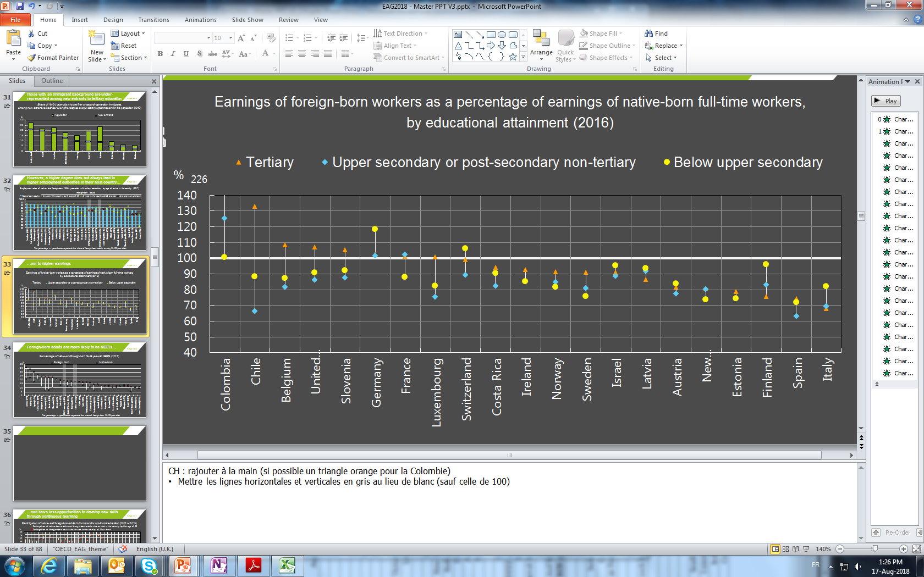
…and regardless of their educational attainment they earn a little less than their native-born peers
Figure A4.4
Earnings of foreign-born workers as a percentage of earnings of native-born full-time workers,
by educational attainment (2016)
226

