Slide 1





Apvārsnis Eiropa pētniecības klastera «Digitālā joma, rūpniecība un kosmoss» darba programma un aktuālie IKT konkursi.
Jūlija Asmuss, Dr.sc.ing.
Nacionālā kontaktpunkta
vecākā eksperte
julija.asmuss@viaa.gov.lv

Slide 2

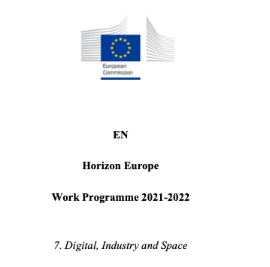

Apvārsnis Eiropa 4. klastera darba programma
info: https://ec.europa.eu/info/horizon-europe/cluster-4-digital-industry-and-space_en
darba programma: https://ec.europa.eu/info/funding-tenders/opportunities/docs/2021-2027/horizon/wp-call/2021-2022/wp-7-digital-industry-and-space_horizon-2021-2022_en.pdf

Slide 3

DESTINATION 1
CLIMATE NEUTRAL, CIRCULAR AND DIGITISED PRODUCTION
DESTINATION 2
INCREASED AUTONOMY IN KEY STRATEGIC VALUE CHAINS FOR RESILIENT INDUSTRY
DESTINATION 3
WORLD LEADING DATA AND COMPUTING TECHNOLOGIES
DESTINATION 4
DIGITAL AND EMERGING TECHNOLOGIES FOR COMPETITIVENESS AND FIT FOR THE GREEN DEAL
DESTINATION 5
OPEN STRATEGIC AUTONOMY IN DEVELOPING, DEPLOYING AND USING GLOBAL SPACE-BASED INFRASTRUCTURE, SERVICES, APPLICATIONS AND DATA
DESTINATION 6
A HUMAN-CENTRED AND ETHICAL DEVELOPMENT OF DIGITAL AND INDUSTRIAL TECHNOLOGIES

Slide 4
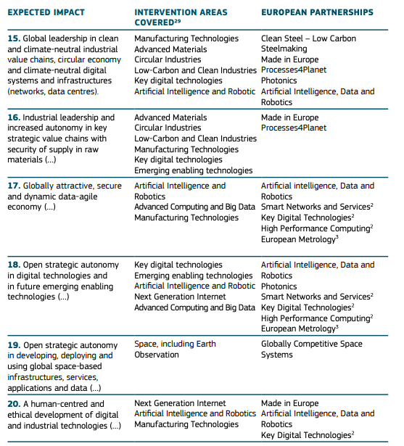
Strategic Plan: https://ec.europa.eu/info/sites/info/files/research_and_innovation/funding/documents/ec_rtd_horizon-europe-strategic-plan-2021-24.pdf

Slide 5

Tehnoloģijas
Ražošanas tehnoloģijas
Progresīvi materiāli
Nākamās paaudzes internets
Aprites nozares
Kosmoss, tostarp Zemes novērošana
Jaunās pamattehnoloģijas
Digitālās pamattehnoloģijas, tostarp kvantu tehnoloģijas

Slide 6
Projektu tipi
Type | Activities | Page limit | Financing rate
RIA (Research and Innovation Actions) | Activities to establish new knowledge or to explore the feasibility of a new or improved technology, product, process, service or solution. | 45 pages | Up to 100%
IA (Innovation Actions) | Activities to produce plans and arrangements or designs for new, altered or improved products, processes or services. | 45 pages | *Up to 70%
CSA (Coordination and Support Actions) | Activities that contribute to the objectives of Horizon Europe. This excludes R&I activities, except for ‘Widening participation and spreading excellence’. | 30 pages | Up to 100%
* the rate is 70 percent for profit-making legal entities and 100 percent for non-profit legal entities

Slide 7
Projektu tipi
Research & Innovation Actions | Innovation Actions
Basic & applied research | Limited R&D activities
Testing / validation on small-scale prototype (in lab or simulated environment) | Prototyping, testing, large-scale product validation & market replication
Limited demo or pilot activities (to show tech feasibility in a near to operational environment) | Demo or pilot activities (to show tech feasibility in operational environment)
Developing innovations meeting needs of markets | Developing innovations meeting needs of markets & their delivery to market
Exploitation activities
Innovation management

Slide 8
Technology Readiness Level
Technology Readiness Levels (TRLs) are indicators of the maturity level of particular technologies.
TRL 1 – basic principles observed
TRL 2 – technology concept formulated
TRL 3 – experimental proof of concept
TRL 4 – technology validated in lab
TRL 5 – technology validated in relevant environment (industrially relevant environment in the case of key enabling technologies)
TRL 6 – technology demonstrated in relevant environment (industrially relevant environment in the case of key enabling technologies)
TRL 7 – system prototype demonstration in operational environment
TRL 8 – system complete and qualified
TRL 9 – actual system proven in operational environment (competitive manufacturing in the case of key enabling technologies; or in space)

Slide 9

D3: World Leading Data and Computing Technologies
https://www.youtube.com/watch?v=SevWyhwaEwE
Opening date: 23 November 2021
Deadline: 5 April 2022
Topic | Type of action, TRL | EU contribution per project (EUR million) | Number of projects to be funded
HORIZON-CL4-DATA-2022-01-01 Methods for exploiting data and knowledge for extremely precise outcomes (analysis, prediction, decision, support), reducing complexity and presenting insights in understandable way | RIA TRL 2-3/TRL 4-5 | 8-12 | 3
HORIZON-CL4-DATA-2022-01-02 Cognitive Cloud: AI-enabled computing continuum from Cloud to Edge | RIA TRL 2/TRL 5 | 4-6 | 10
HORIZON-CL4-DATA-2022-01-03 Programming tools for decentralised intelligence and swarms | RIA TRL 2/TRL 5 | 4-8 | 5
HORIZON-CL4-DATA-2022-01-04 Technologies and solutions for data trading, monetizing, exchange and interoperability | IA TRL 4/TRL 7 | 10-13 | 4
HORIZON-CL4-DATA-2022-01-05 Extreme data mining, aggregation and analytics technologies and solutions | RIA TRL 3/TRL 5 | 5 | 6

Slide 10
HORIZON-CL4-2022-DATA-01-01
What are we looking for?
technologies for data assets that are beyond reach of existing technologies in terms of volume, velocity, variety.
precise and timely analytics, prediction, simulation and visualization
responsible and trustworthy technologies
Is this new or has it been called before?
While data technologies aren’t entirely new, we are now looking for extreme* data technologies
*data that exhibits one of the following characteristics to the extent that they cannot be handled by 2022 technologies
- increasing volume, speed, variety; complexity/diversity/multilinguality of data; the dispersed data sources; sparse/missing/insufficient data/extreme variations in values
What we do NOT want?
solutions for data contexts that can already be handled by existing technologies
proposals that don’t specify their performance goals or don’t explain how they will monitor their progress towards those goals
visualization tools that are not usable by a typical end user of data analytics
Current project portfolio
• https://daphne-eu.github.io
• https://everest-h2020.eu
• https://www.marvel-project.eu/

Slide 11
HORIZON-CL4-2022-DATA-01-02
What are we looking for?
Development of generic and advanced cloud technologies, mechanisms, techniques, etc. Research in cloud technologies! not in AI
The proposals should demonstrate the applicability and viability of the proposed technological solutions across multiple application domains.
Beyond State-of-the-art, not incremental type of research
Current project portfolio
H-CLOUD https://www.h-cloud.eu/
Hub4CLOUD https://www.h-cloud.eu/ict_40-projects/hub4cloud/
Additional information
https://digital-strategy.ec.europa.eu/en/policies/cloud-computing
https://digital-strategy.ec.europa.eu/en/library/cloud-and-edge-computing-different-way-using-it-brochure
What we do NOT want?
Using existing Cloud technologies as an enabler for research in other domains (e.g., AI, IoT, BigData, etc.)
Any User Application development using existing Cloud technologies

Slide 12
HORIZON-CL4-2022-DATA-01-03
What are we looking for?
New decentralized architectures for smart nodes, Swarm Intelligence
Programming tools for decentralized intelligent nodes, Open source, where applicable
The proposals should demonstrate the applicability and validation of the proposed concepts in at least 3 application domains, Contribution to SDGs
Future Outlook:
Portal for projects, open calls and events: www.NGIOT.eu
Study Economic Potential of Far Edge Computing in the Future Smart IoT launched on 06/07/2021
Portal Shaping Europe’s Digital Future Roadmap published by the Alliance on Industrial Data and Cloud
What we do NOT want?
Proprietary technology development ! need to consider open interfaces and standards, where applicable build on open source projects
Narrowly focused scope, need interdisciplinary proposals SW-HW-network, need to connect different dots IoT, EPI, cloud, ARTEMIS, KDT, SNS.
Events
Workshop Autonomy in the Computing Continuum on 11/11/2021
see https://www.ngiot.eu/events/ Report to follow
InfoDay – planned end January for Matchmaking t.b.c.

Slide 13
HORIZON-CL4-2022-DATA-01-04
What are we looking for?
data market/ data economy enablers
technologies, solutions, frameworks that facilitate the collection, sharing, storing, processing, trading and re-using of data
practical and scalable solutions for handling large amounts of transactions while minimizing energy consumption
development and demonstration of practical and mature end-to-end systems
Is this new or has it been called before?
privacy-preserving technologies and data platforms have been addressed in H2020 (ICT- 18-2016, ICT-13-2018-19) – but this is the first time we specifically address data trading
link to the Digital Europe programme: actions are expected to support the deployment of the Common European Data Spaces
What we do NOT want?
duplicates of privacy-preserving technologies and data platforms already funded under H2020
project proposals lacking energy-efficiency as a design principle
theoretic/ research projects – this is an IA topic with TRL 7 by the end of project
Current project portfolio
Examples of Data Platforms ICT-13-2019:
DATA VAULTS (IA)
PIMCITY (IA)
Examples of privacy-preserving technology projects ICT-13-2018:
MOSAICrOWN (RIA)
Safe-DEED (RIA)
MUSKETEER (RIA)
Partnership driving this
European Partnership on AI, data and robotics

Slide 14
HORIZON-CL4-2022-DATA-01-05
What are we looking for?
Tools to provide better technologies and solutions for data mining of large, constantly growing amounts and varieties of data.
Solutions to provide ground-breaking advances in the performance, speed and/or accuracy as well as use- fulness of data discovery, collection, mining, filtering and processing in view of coping with “extreme data”.
These solutions should enable accurate, green and fair AI systems where quality of data is of utmost impor- tance.
Is this new or has it been called before?
While data technologies aren’t entirely new, we are now looking for extreme* data technologies
*data that exhibits one of the following characteristics to the extent that they cannot be handled by 2022 technologies
- increasing volume, speed, variety; complexity/diversity/multilinguality of data; the dispersed data sources; sparse/missing/insufficient data/extreme variations in values
What we do NOT want?
Anything theoretical or unrealistic/non-functional
Documents
A European strategy for data (February 2020)
Proposal for a Regulation on European Data Governance
Towards a European-Governed Data Sharing Space (November 2020)
Partnership driving this
Big Data Value PPP (H2020 partnership)
European Partnership on AI, data and robotics

Slide 15
D4: Digital and Emerging Technologies for Competitiveness and Fit for the Green Deal
https://www.youtube.com/watch?v=4NtbWbUKyhU
Opening date: 28 October 2021
Deadline: 27 January 2022
Topic | Type of action, TRL | EU contribution per project (EUR million) | Number of projects to be funded
HORIZON-CL4-DIGITAL-EMERGING-2021-02-20 Quantum sensing technologies for market uptake | IA TRL 4-5/TRL 6-7 | 4-6 | 6
HORIZON-CL4-DIGITAL-EMERGING-2021-02-10 Strengthening the quantum software ecosystem for quantum computing platforms | RIA TRL 2-3/TRL 4-5 | 3-5 | 8
HORIZON-CL4-DIGITAL-EMERGING-2021-02-16 Basic Science for Quantum Technologies | RIA TRL 2/TRL 4 | 3 | 1
Opening date: 21 December 2021
Deadline: 5 April 2022
HORIZON-CL4-DIGITAL-EMERGING-2022-01-26 Open source for cloud-based services | RIA TRL 4/TRL 7 | 4-6 | 4
HORIZON-CL4-DIGITAL-EMERGING-2022-01-38 International cooperation in semiconductors | CSA | 3 | 1
HORIZON-CL4-DIGITAL-EMERGING-2022-01-03 Advanced multi-sensing systems | RIA TRL 2/TRL 5 | 3-5 | 10

Slide 16
HORIZON-CL4-2022-DIGITAL-EMERGING-02-20
What are we looking for?
New multifunctional recyclable materials enabling solutions to environmental issues.
2DM composites, coatings and foams mainly addressing environmental issues.
Development of lightweight composites and coatings with key functionalities
Metal 2DM composites enabling ulralow frictions
2DM foams for catalytic hydrogen generation and storage
Documents
Consultation workshop, Jan. 2020, report:
https://digital-strategy.ec.europa.eu/en/library/consultation-report-graphene-and-related-materials-now-available
Technology and Innovation roadmap:
https://graphene-flagship.eu/innovation/industrialisation/roadmap/
Current project portfolio
Graphene Flagship
https://graphene-flagship.eu/
Annual reports: https://grapheneflagship.eu/research/annual-report/
2D Experimental Pilot Line
https://graphene-flagship.eu/innovation/pilot-line/
Is this new or has it been called before?
Continuation of the Graphene Flagship
Significant change in implementation; FPA/SGAs vs RIAs/IA and one CSA
There are several topics in the current WP, outside of « Graphene: Europe in the lead » where 2DM based technologies can compete.

Slide 17
HORIZON-CL4-2022-DIGITAL-EMERGING-01-26
What are we looking for?
Virtual environments, methods and tools
Simulation of targeted architectures
Development and coordination with relevant software distributions
Open source interfaces that permit the deployment of tested stacks on the outcomes of European processor initiatives. Proposals should address at least one of these points:
Open hardware interfaces
Software to provide the basic initialization
Is this new or has it been called before?
Topics funded under Horizon 2020:
ICT-15-2019 Cloud Computing
ICT-16-2018 Software Technologies
ICT-40-2020 Cloud Computing: Towards a smart cloud computing continuum
ICT-50-2020 Software Technologies
European Processor Initiative
New relevant Processing architectures
Relevant Stakeholders
Electronics industry
Software industry
Universities
Supercomputing centers
Data centers
Stakeholders in the area of the EPI
What we do NOT want?
TRL 1-3 developments
Standalone modules
Development of Interfaces for unimplemented services
Work on dominant market-established processing architectures

Slide 18
HORIZON-CL4-2022-DIGITAL-EMERGING-01-03
What are we looking for?
increased integration of new functionalities, decreased size
cost-effective manufacturing
Key integration and packaging technologies
Manufacturing value chains.
High levels of reuse/repair/repurpose
Recovery and recycling of waste and materials
Reduce of power consumption by a factor of 2.
healthcare and well-being
environmental monitoring and protection
transport and automated driving
Manufacturing
Aerospace and security
Is this new or has it been called before?
In the past we called research on sensing in conjunction with specific application domains such as health, agro/food and manufacturing
This time application range is open; yet the developed solution should be usable (with not too much effort) in different application domains
For the project portfolio please see website of the partnership www.photonics21.org
Documents
SRIA
Photonics Market Data and Industry Report 2020
Photonics Partnership MoU
Trends
Miniaturisation
Integration of functional elements on chip
Modularisation
Design tool/ simulation support

Slide 19
D4: Digital and Emerging Technologies for Competitiveness and Fit for the Green Deal
https://www.youtube.com/watch?v=4NtbWbUKyhU
Opening date: 21 December 2021
Deadline: 5 April 2022
Topic | Type of action, TRL | EU contribution per project (EUR million) | Number of projects to be funded
HORIZON-CL4-DIGITAL-EMERGING-2022-01-30 European Enabling technologies for Beyond 5G/6G RAN disaggregated architectures | RIA TRL 2-3/TRL 4-5 | 13 | 1
HORIZON-CL4-DIGITAL-EMERGING-2022-01-39 Ultra low energy and secure networks | RIA TRL 2-3/TRL 6 | 13 | 1
HORIZON-CL4-DIGITAL-EMERGING-2022-01-05 AI, data and robotics for industry optimisation (including production and services) | IA TRL 3-5/TRL 6-7 | 3-5 | 5
HORIZON-CL4-DIGITAL-EMERGING-2022-01-06 Pushing the limit of physical intelligence and performance | RIA TRL 2-3/TRL 4-5 | 4 | 7
HORIZON-CL4-DIGITAL-EMERGING-2022-01-07 Increased robotics capabilities demonstrated in key sectors | IA TRL 3-5/TRL 6-7 | 6 | 6
HORIZON-CL4-2022-DIGITAL-EMERGING-01-35 Advanced characterisation methodologies to assess and predict the health and environmental risks of nanomaterials | RIA TRL 3/TRL 5 | 2-3 | 5

Slide 20
HORIZON-CL4-2021-DIGITAL-EMERGING-01-30
What are we looking for?
Strong contributions from the microelectronics supply chain
Gaining leadership in development through forward-looking research
Create an advanced microelectronics supply chain for European sovereignty
Stimulate the emergence of a European source of hardware components/processors/DSP/ accelerators as will be needed to run the processes of disaggregated RAN infrastructures
Current project portfolio
The call logic is placed in the context of an extension of the work and results of the Corenect CSA project, as an important tool to design our approach towards enabling hardware technologies (computing, DSP, memories, chipset, sensors..) in support of future connectivity infrastructures, while bridging the telecom domain and the component domain (in particular SNS and KDT)
What we do NOT want?
The outcome is primarily on EU hardware computing capabilities (e.g. computing, processors, DSP), not to dedicated software capabilities.
Key actors
5G PPP https://5g-ppp.eu/
Corenect project
Networld ETP (partially)
Smart Network and Services (6G) partnership https://digital-strategy.ec.europa.eu/en/policies/smart-networks-and-services-joint-undertaking
Key initiatives
ORAN alliance, TIP project, Intel FlexRAN, ARM

Slide 21
HORIZON-CL4-2021-DIGITAL-EMERGING-01-39
What are we looking for?
Strong interactions between the telecom and the microelectronics/photonics communities, looking at a combined ”system and enabling technologies” perspective.
Involvement of the security community for the ”ultra secure” part.
Current project portfolio
5G PPP projects on optical communications (e.g. Bluespace, Metro-Haul).
Projects from the photonics partnership working on telecom optical networks (Working Group 1 of Photonic PPP)
Key actors
5G PPP https://5g-ppp.eu/
Networld ETP
Smart Network and Services (6G) partnership https://digital-strategy.ec.europa.eu/en/policies/smart-networks-and-services-joint-undertaking
What we do NOT want?
Monolithic community participation (e.g. only telecom)
Short term solutions (all optical networks remain a long term prospect)
Documents
SRIA: https://www.networld2020.eu/sria-and-whitepapers/

Slide 22
HORIZON-CL4-2021-DIGITAL-EMERGING-01-05
What are we looking for?
Maximise impact (Major industrial sector + demonstrate clear benefits)
Integrate and optimise AI, data and robotics solutions to demonstrate how they can contribute to the Use-Case
Test in actual / highly realistic operating environments - boost deployment
Right mix of expertise
BOTH Robotics and non-Robotics AI encouraged – ideal: combination AI-Data-Robotics
BOTH Small (focused) and Large (FSTP) projects - encourage GOOD FSTP as well
Two types of proposals:
Small (focused projects)
user industry
technology providers
Larger projects
Challenges from user companies
Must include FSTP:
  >40% of the budget
  up to 200K€/TP
  TP = SMEs (70% funding) and start-ups (100% funding)
What we do NOT want?
Major Research component - BUT build on latest developments
Tech push / Invented problems
Niche sectors with limited impact
Anything artificial - BUT everything optimized towards the project objectives

Slide 23
HORIZON-CL4-2021-DIGITAL-EMERGING-01-06
What are we looking for?
Robots physical capabilities relevant to industry and service needs - actuation, miniaturization, control, trustworthiness, dependability
Performance and interaction of robots in real world tasks - where testability is limited
Rethink robot bodies -physical and interaction capabilities, any size/type of activity/environment, build on underlying technologies, energy efficiency, cognitive mechatronics.
All proposals expected to
Demonstrate Progress:
qualitative and quantitative KPIs
demonstrators benchmarking & progress monitoring
Expected outcomes
Advanced Physical functionality /capa / efficiency / Beyond Human
Safe/Efficient physical interaction
Adapt to change - long-term autonomy & Trustworthy/Dependable
What we do NOT want?
Incremental progress
Applications of Limited impact
Invented/Tech push problems/validation scenarios
« Artificial multidiciplinarity » not driven by projects objectives

Slide 24
HORIZON-CL4-2021-DIGITAL-EMERGING-01-07
What are we looking for?
Ambitious: Step change, High Impact sectors/Use-Cases, Major benefit from Robotics
High visibility
Mutlidisciplinarity: dictated by the projects needs (tech development vs. use)
Current project portfolio
Projects funded under H2020 in Robotics/Big Data/AI
https://digital-strategy.ec.europa.eu/en/library/horizon-2020-new-robotics-projects-2021
https://www.eu-robotics.net/sparc/projects/robotics-projects-funded-by-horizon2020.html?changelang=2
DIHs in robotics: https://ri4eu.eu/
BDVA projects: https://www.bdva.eu/ppp-projects
AI-on demand platform (ICT26 + ICT49): https://www.ai4europe.eu/
What we do NOT want?
Incremental progress
Applications of Limited impact
Invented/Tech push problems/validation scenarios
« Artificial multidiciplinarity » not driven by projects objectives
Key actors
PPP on AI, Data and Robotics - https://ai-data-robotics-partners
Documents
Coordinated plan on AI: https://digital-strategy.ec.europa.eu/en/library/coordinated-plan-artificial-intelligence-2021-review

Slide 25
D4: Digital and Emerging Technologies for Competitiveness and Fit for the Green Deal
https://www.youtube.com/watch?v=4NtbWbUKyhU
Opening date: 16 June 2022
Deadline: 16 November 2022
Topic | Type of action, TRL | EU contribution per project (EUR million) | Number of projects to be funded
HORIZON-CL4-DIGITAL-EMERGING-2022-02-17 New generation of advanced electronic and photonic 2D materials-based devices, systems and sensors | RIA TRL 3/TRL 5 | 16,5 | 1
HORIZON-CL4-DIGITAL-EMERGING-2022-02-18 2D materials-based devices and systems for energy storage and/or harvesting | RIA TRL 3/TRL 4-5 | 9 | 1
HORIZON-CL4-DIGITAL-EMERGING-2022-02-19 2D materials-based devices and systems for biomedical applications (RIA) | RIA TRL 3/TRL 4-5 | 6 | 1
HORIZON-CL4-DIGITAL-EMERGING-2022-02-20 2D-material-based composites, coatings and foams | IA TRL 4-5/TRL 6-7 | 9 | 7
HORIZON-CL4-DIGITAL-EMERGING-2022-02-22 Supporting the coordination of the Graphene Flagship projects | CSA | 3 | 6

Slide 26
HORIZON-CL4-2021-DIGITAL-EMERGING-01-17
What are we looking for?
New technological solutions providing significant advances towards the integration of 2DM technology and the emergence of competitive value chains
development of 2DM-based devices and systems bringing 2DM technology one step further towards the integration in current technologies
2DM-based sensors, electronic and photonic devices and systems
Demonstrate added-value compared to current technologies
Modelling, design, manufacturing and characterisation
Assess routes for integration and indicate plans to work with the 2D-EPL.
What are we looking for?
Integrate the value chain and manufacturing technologies
Include activities for future exploitation of results
Start at TRL3-4 and achieve TRL 5
Contribute to the governance and coordination of the Graphene Flagship initiative.

Slide 27
HORIZON-CL4-2021-DIGITAL-EMERGING-01-18
What are we looking for?
Energy storage devices and systems with demonstrated added-value
New solutions for portable energy sources
Solutions demonstrating the added value of 2DM based energy storage devices and systems
Structural batteries and structural supercapacitors
Devices for energy conversion
What are we looking for?
Integrate the value chain and manufacturing technologies
Include activities for future exploitation of results
Start at TRL3-4 and achieve TRL 5
Contribute to the governance and coordination of the Graphene Flagship initiative.

Slide 28
HORIZON-CL4-2021-DIGITAL-EMERGING-01-19
What are we looking for?
New technology solutions based on 2DM for biomedical applications.
Devices and systems building of the multi-functionality of 2DM and demonstrate their advantages.
Address how the devices and systems will reach the clinic
Need to gather multidisciplinary teams
Potential application areas: diagnostic, therapeutic devices, brain-computer interfaces, medical imaging, drug delivery…
Safety aspects
What are we looking for?
Include activities for future exploitation of results
Start at TRL3-4 and achieve TRL 5
Contribute to the governance and coordination of the Graphene Flagship initiative.

Slide 29
HORIZON-CL4-2021-DIGITAL-EMERGING-01-20
What are we looking for?
New multifunctional recyclable materials enabling solutions to environmental issues.
2DM composites, coatings and foams mainly addressing environmental issues.
Development of lightweigh composites and coatings with key functionalities
Metal 2DM composites enabling ulralow frictions
2DM foams for catalytic hydrogen generation and storage
What are we looking for?
‘Must’ include Life Cycle Assessment and end-of-life materials management
Integrate the value chain and manufacturing technologies
Include activities for future exploitation of results
Start at TRL4-5 and achieve TRL 6-7
Contribute to the governance and coordination of the Graphene Flagship initiative.

Slide 30
HORIZON-CL4-2021-DIGITAL-EMERGING-01-22
What are we looking for?
New multifunctional recyclable materials enabling solutions to environmental issues.
2DM composites, coatings and foams mainly addressing environmental issues.
Development of lightweight composites and coatings with key functionalities
Metal 2DM composites enabling ulralow frictions
2DM foams for catalytic hydrogen generation and storage
What are we looking for?
‘Must’ include Life Cycle Assessment and end-of-life materials management
Integrate the value chain and manufacturing technologies
Include activities for future exploitation of results
Start at TRL4-5 and achieve TRL 6-7
Contribute to the governance and coordination of the Graphene Flagship initiative.

Slide 31
D6: A Human-Centred and Ethical Development of Digital and Industrial Technologies
https://www.youtube.com/watch?v=x65cn1Lq090
Opening date: 21 December 2021
Deadline: 5 April 2022
Topic | Type of action, TRL | EU contribution per project (EUR million) | Number of projects to be funded
HORIZON-CL4-HUMAN-2022-01-01 AI for human empowerment | RIA TRL 2-3/TRL 4-5 | 4 | 4
HORIZON-CL4-HUMAN-2022-01-02 European Network of AI Excellence Centres: Expanding the European AI lighthouse | RIA TRL 2-3/TRL 4-5 | 11,5 | 3
HORIZON-CL4-HUMAN-2022-01-03 Internet architecture and decentralised technologies | RIA | 11 | 2
HORIZON-CL4-HUMAN-2022-01-05 Next Generation Safer Internet: Technologies to identify digital Child Sexual Abuse Material (CSAM) | RIA TRL 3/TRL 7 | 2 | 1
HORIZON-CL4-HUMAN-2022-01-07 NGI International Collaboration - USA and Canada | RIA | 6 | 1
HORIZON-CL4-HUMAN-2022-01-14 eXtended Reality Technologies | RIA TRL 2-3/TRL 4-5 | 5-8 | 3
HORIZON-CL4-HUMAN-2022-01-19 eXtended Reality Learning - Engage and Interact | IA TRL 4/TRL 6-7 | 5-8 | 3

Slide 32
HORIZON-CL4-2022-HUMAN-01-01
What are we looking for?
Next level of perception, visualisation, interaction and collaboration between humans and AI systems working together as partners to achieve common goals, sharing mutual understanding and learning of each other’s abilities and respective roles.
Innovative and promising approaches including human-in the loop approaches for truly mixed human-AI initiatives combining the best of human and machine knowledge and capabilities, tacit knowledge extraction (to design the next generation AI-driven co-creation and collaboration tools embodied e.g. in industrial/working spaces environments).
What we do NOT want?
Scientific progress disconnected from industry needs / incremental – lack of ambition
Purely technical approach (SSH is an integral part of the research)
Expected outcome
Truly mixed human-AI initiatives for human empowerment
Trustworthy hybrid decision-support systems
Solid Scientific development in SELECT ONE OF THE 2 FOCUS
Demonstrate potential benefits in particular applications
Human- centered development of TRUST-WORTHY AI
Key actors
AI, Data and Robotics Partnership

Slide 33
HORIZON-CL4-2022-HUMAN-01-02
What are we looking for?
Scientific progress in AI, addressing major challenges hampering its deployment, including systems engineering.
Build-up the European AI lighthouse, initiated by earlier Networks of excellence centers
Unify and reinforce the world-class European AI community - Create strong visibility & identity for the vibrant AI community in Europe
Is this new or has it been called before?
ICT-48 all together will form part of the AI lighthouse
HORIZON-CL4-2021-HUMAN-01-03 (focus on safe and secure AI)
Current project portfolio
AI-on-demand platform (ICT26 – ICT 49) => 7 projects
ICT-48 – 4 NoEs + 1 CSA
Documents
PPP – SRIDA: https://ai-data-robotics-partnership.eu/
European AI Strategy: https://digital-strategy.ec.europa.eu/en/policies/european-approach-artificial-intelligence
White paper on AI: Ecosystem of excellence & Trust
What we do NOT want?
Second-Class experts in AI
Disjoint efforts of the AI community to address the research challenge

Slide 34
HORIZON-CL4-2022-HUMAN-01-03
What are we looking for?
The objective of this section is to develop a trustworthy digital environment, built on a more resilient, sustainable, and decentralised internet, to empower end-users with more control over their data and their digital identity, and to enable new social and business models respecting European values
Is this new or has it been called before?
All the information on current NGI projects is available at: https://www.ngi.eu/ngi-projects/
This includes projects from previous H2020 calls in the same areas as the current topics
What we do NOT want?
apps and services that innovate without a research component are not covered by this topic

Slide 35
HORIZON-CL4-2022-HUMAN-01-05
What are we looking for?
Create AI tools and technologies (including classifiers) which allow identification, categorization and prioritization of Child Sexual Abuse Material (CSAM).
The tools should combine different sources of informations and clues (images, videos, object identification, sound, text, age detection…) in order to make the results (the hits) more accurate
Specific issue to be addressed is that the tools comply with the divers national definitions of CSAM in EU Member States to allow cross-border interoperability.
Project will develop the classifier.
Project will compose and annotate representative CSAM data sets, train, and test the tools in cooperation with LEAs and INHOPE Hotlines.
What we do NOT want?
We are not looking for hashing technologies. We are not looking for tools which only rely on the analysis and classification of visual material.
Is this new or has it been called before?
GRACE - https://cordis.europa.eu/project/id/883341
www.grace-fct.eu
AviaTor – https://ec.europa.eu/info/funding-tenders/opportunities/portal/screen/how-to-participate/org-details/942970272/project/101038713/program/31077817/details
https://web-iq.com/news/aviator-phase-2-creating-the-tool-to-get-the-job-done

Slide 36
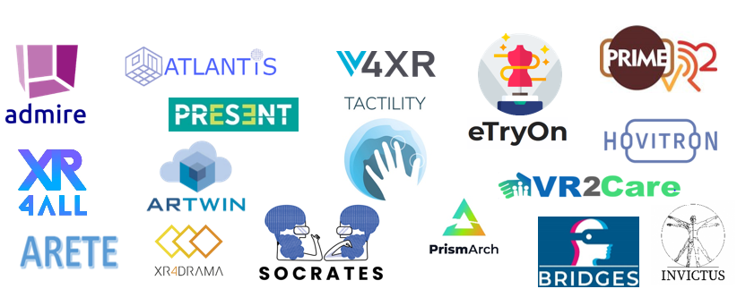
HORIZON-CL4-2022-HUMAN-01-14
What are we looking for?
Digital interfaces, spatial computing, interaction with real-time contextual information, multi-user, multi-sensory experiences, 3D acquisition, processing, storage and rendering, context-aware and embodied experiences, realistic digital avatars and intelligent agents. Fully tested real-world scenarios.
Is this new or has it been called before?
This topic builds on:
H2020:
ICT-25-2018-2020 (Interactive Technologies): 6 RIA (Future Interaction) / 1 CSA (Interactive Community Building)
ICT-55-2020: 10 IA (The uptake of Interactive Technologies in various industrial and societal domain)
What we do NOT want?
State-of-the-art applications
Non suitable, unethical or unsafe solutions
Research non-grounded into real world scenarios
Non-transdisciplinary research
Research that does not involve end-users

Slide 37
HORIZON-CL4-2022-HUMAN-01-19
What are we looking for?
Innovative XR-enabled solutions for education, awareness raising, training, distance and blended learning, accessibility and inclusion
Open access – educational solutions to match needs
A place for sharing/marketing existing digital educational XR solutions for EdTech and XR communities
FSTP to support digital start-ups, SMEs and industry in the education area
Linked to existing relevant initiatives (e.g. existing platforms, catalogues or repositories)
What we do NOT want?
Actions exclusively focused on research rather than innovation
Unclear idea of impact and sustainability
Lack of connection to/ exploitation of existing relevant initiatives/solutions
Poor overall concept of the platform and unclear coordination of the TP projects
Access availability issues, low usability, user-unfriendly tools
Documents
XR4ALL Landscape Report, Research agenda (Dec.2020)
Technologies for better human learning and teaching (2015), Gaming and gamification (2016), Interactive Technologies (2018), An empowering, inclusive Next Generation Internet (2019)
Is this new or has it been called before?
ICT-25-2018-2020
ICT-55-2020

Slide 38
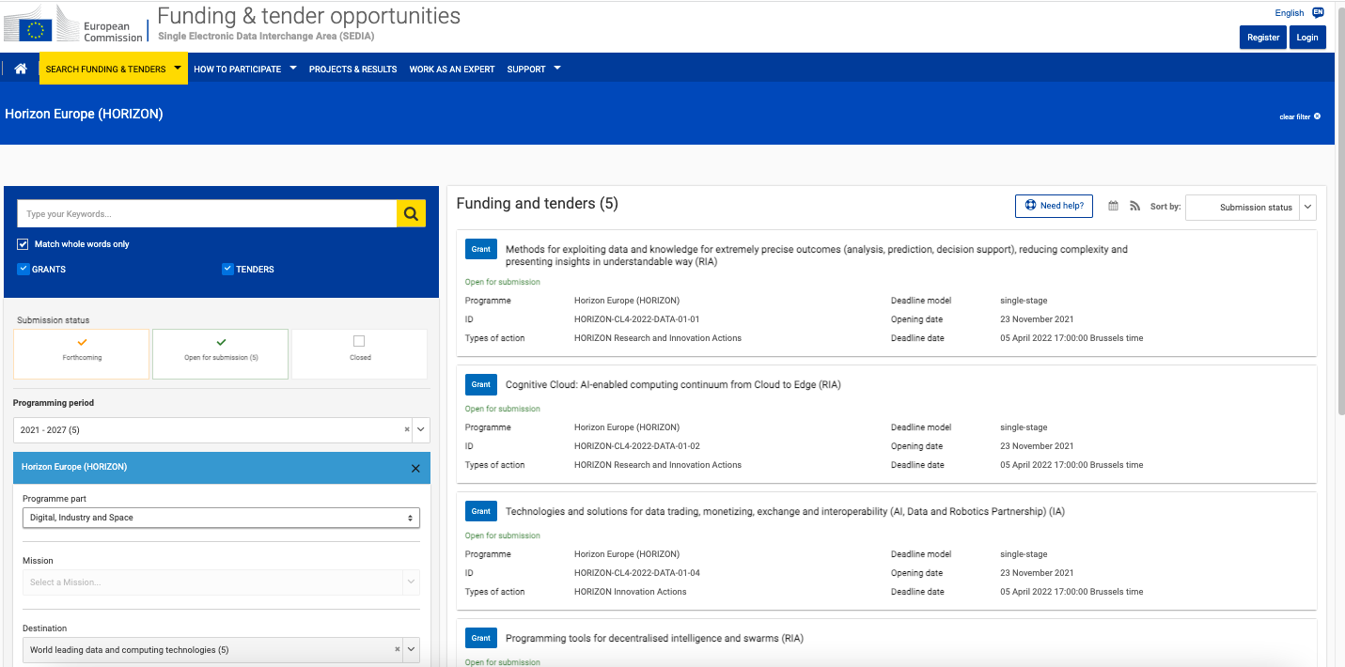
Funding & tender opportunities
portal:https://ec.europa.eu/info/funding-tenders/opportunities/portal/screen/opportunities/topic-search

Slide 39
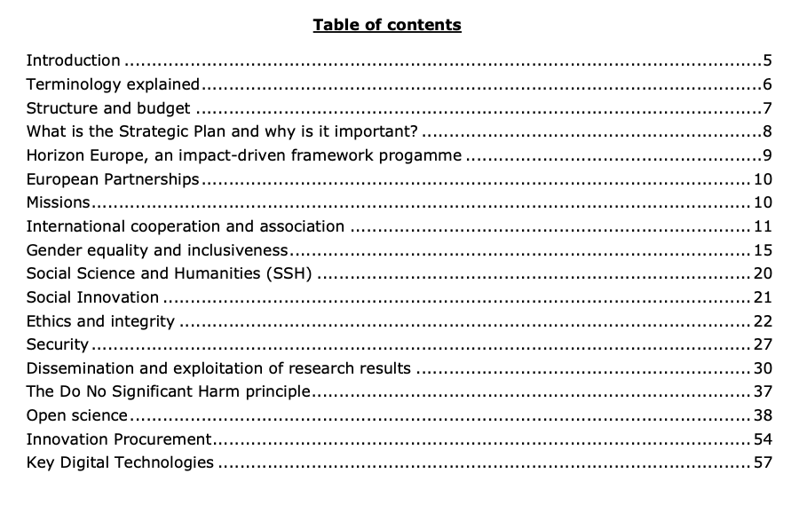

Programme guide
info: https://ec.europa.eu/info/funding-tenders/opportunities/docs/2021-2027/horizon/guidance/programme-guide_horizon_en.pdf

Slide 40
VIAA vebināri
https://www.viaa.gov.lv/lv/pasakumi
Tehniski un administratīvi jautājumi dalībai Apvārsnis Eiropa programmā
VIAA vebināra prezentācija: https://www.viaa.gov.lv/lv/media/14475/download
VIAA vebināra video ieraksts: https://youtu.be/ZpA1myFfdFs
Dzimumu līdztiesības plāns Apvārsnis Eiropa projektos
VIAA vebināra prezentācija: https://www.viaa.gov.lv/lv/media/11688/download
VIAA vebināra video ieraksts: https://youtu.be/uBEUJh2gZzM
Dzimumu līdztiesības plāns (obligāts no 2022. gada)
Dalībniekiem, kas ir valsts iestādes, pētniecības organizācijas vai augstākās izglītības iestādes no dalībvalstīm un asociētajām valstīm, ir jābūt dzimumu līdztiesības plānam, kas aptver minimālās ar procesu saistītās prasības.
Pašdeklarācija tiks pieprasīta projekta pieteikuma iesniegšanās stadijā (visiem dalībniekiem).

Slide 41
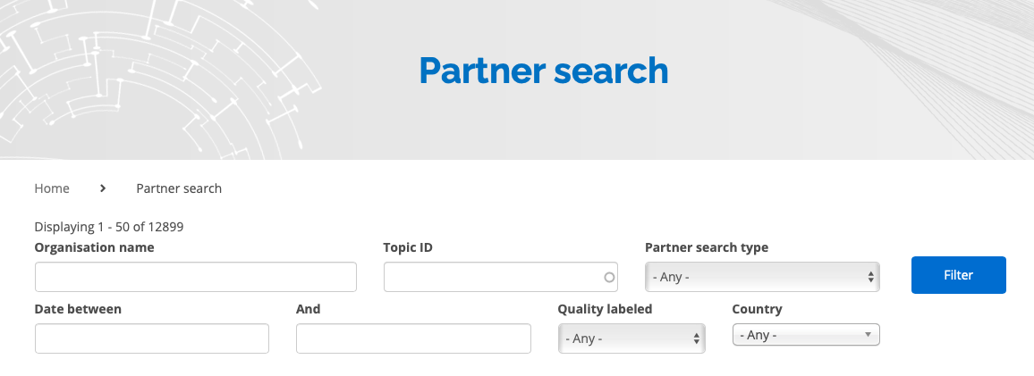
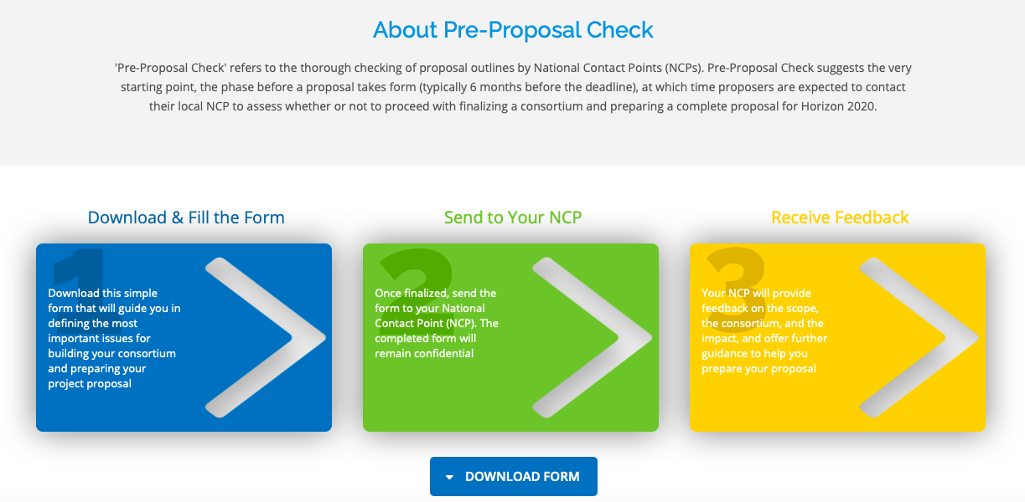
IDEAL-IST project: partner search
https://www.ideal-ist.eu/partner-search-home
http://www.ideal-ist.eu
https://www.ideal-ist.eu/pre-proposal-check

Slide 42
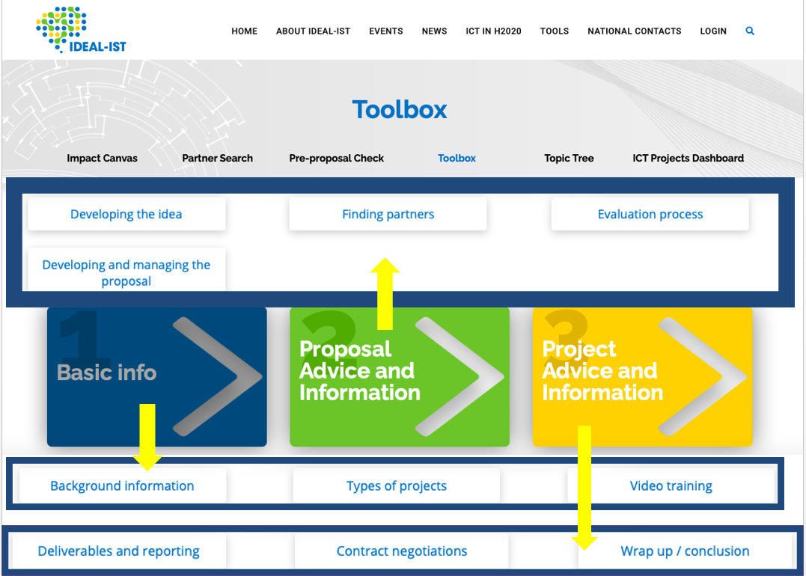
IDEAL-IST project: tools and services
http://www.ideal-ist.eu/toolbox

Slide 43

Ieteikumi projekta sagatavošanai
STRIVE FOR EXCELENCE:
SHOOT FOR IMPACT:
focus exclusively on the calls when you can make a difference with your specific know-how, experience skills, research and innovation
target measurable results in the terms of business results, innovation performance and disruptive technology solutions
how you are going to address the bullet points, do not copy the points
read between-the-lines to assess the call aims
do not address all the listed technologies in one proposal, focus on one
does your proposed project satisfy all the impact requirements of the topic?
benchmark yourself among the other solutions
this section is key to success – study the impact requirements extremely carefully and work backwards from these to form the requisite consortium
test the real World conditions, work with real users

Slide 44
Ieteikumi projekta sagatavošanai
CHOOSE STAR PARTNERS:
  only a strong consortium composed of select partners can
  deliver excellence on time and on budget
NOTE:
  estimated budget window in the call – gives a steer to the appropriate duration/scale of the project and size of consortium that might be expected
BECOME AN EVALUATOR:
  register as an expert for Horizon Europe to gain valuable experience on ‘the other side’
IMPROVE:
  if un successful, do read your Evaluation Summary Report carefully to dis cover where you need to improve in future

Slide 45
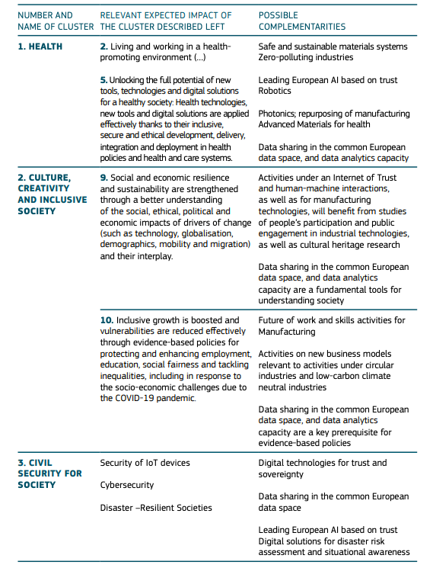

Strategic Plan: https://ec.europa.eu/info/sites/info/files/research_and_innovation/funding/documents/ec_rtd_horizon-europe-strategic-plan-2021-24.pdf

Slide 46
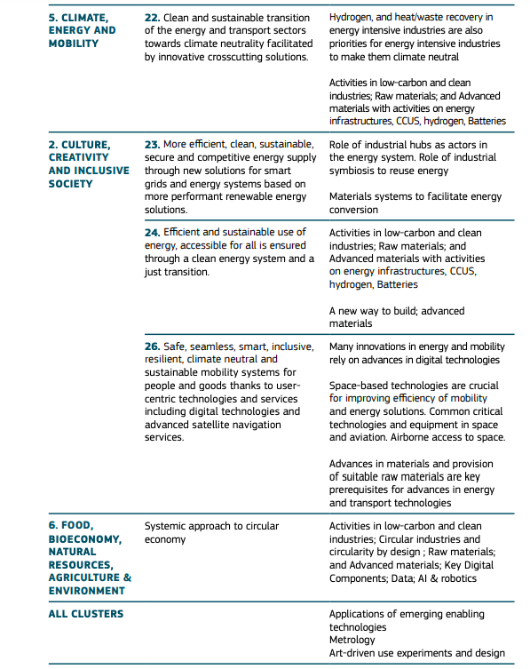

Slide 47
Pasākumi
Digital, Industry and Space info days
Datums: 2021. gada 29. novembrī - 1. decembrī (online)
Video ieraksti:
https://ec.europa.eu/info/research-and-innovation/events/upcoming-events/horizon-europe-info-days/cluster-4_en

Slide 48




PALDIES PAR
UZMANĪBU!
kontakti: https://www.viaa.gov.lv/lv/nacionalais-kontaktpunkts
1.1.1. specifiskā atbalsta mērķa "Palielināt Latvijas zinātnisko institūciju pētniecisko un inovatīvo kapacitāti un spēju piesaistīt ārējo finansējumu, ieguldot cilvēkresursos un infrastruktūrā" 1.1.1.5. pasākuma "Atbalsts starptautiskās sadarbības projektiem pētniecībā un inovācijās" 1.kārtas, projekta Nr.1.1.1.5/17/I/001 “Atbalsts starptautiskās sadarbības projektu izstrādei un īstenošanai” ietvaros

