Slide 1

Introduction to 4th Fixed Call for Proposals under the Requesting Party Activity (RPA) in Latvia
CfP/5-50037/23/NL/MH
Karol Brzostowski
Riga, 12/09/2023

Slide 2
Disclaimer
This presentation material does not contain sufficient information to be used, in any way, in the context of the Fixed Call for Proposals CfP/5-50037/23/NL/MH and CfP/5-50036/23/NL/MH.
This presentation is just to help understand in a simplified manner some of the Rules and Procedures associated with ESA procurements, in particular of these tenders.
Please ensure that your Proposal is compliant with the requirements contained in the Fixed Call for Proposals CfP/5-50037/23/NL/MH and CfP/5-50036/23/NL/MH documentation that will be published on esa-star Publication

Slide 3
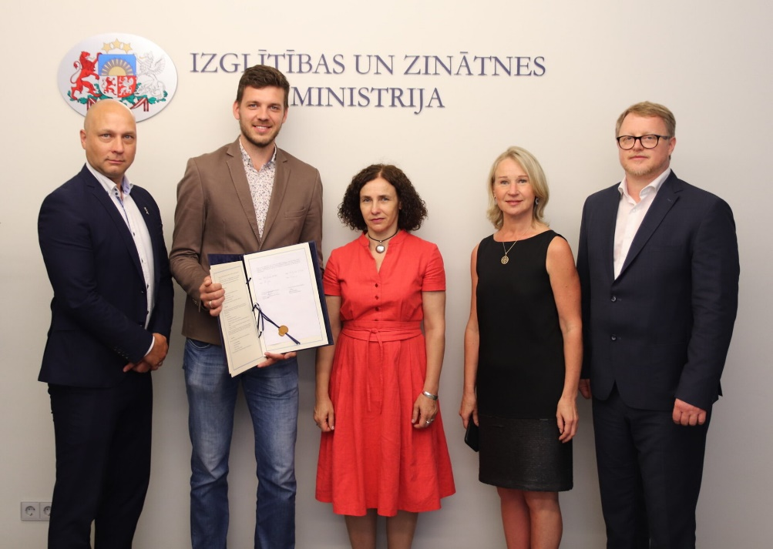
Requesting Party Activity (RPA) Scheme
Latvia signed the Associate Member (AM) agreement on 30 June 2020 and went into force on 27 July 2020:
The RPA scheme is part of the AM agreement and is a funding scheme with a minimum contribution of 500k EUR per year, to further develop the national space industry.
  Latvia is actually contributing more than this!
RPA aims at providing support to Latvian entities to overcome market entry barriers and reach a competitive level for successful participation in multinational ESA programmes.
The goals are:
To prepare the industry to be competitive in ESA optional programmes Latvia subscribes to;
To develop the competences that enable the country to contribute to new ESA optional programmes;
To support space science activities (should the Latvian government wish);
To ensure that a highly educated workforce is available in the country for space related activities.

Slide 4

Summary of the presentation
ESA Tools – Basics of ESA procurement
Overview Type of Activity with respective call
Tender Package for Fixed Call for Proposals
  Cover Letter
  Draft Contract
  Tendering Conditions
  Proposal Template
The Tender Evaluation
The Negotiation Period
Debriefing
Schedule
Questions?
How to write a good proposal (separate presentation)
OSIP (separate presentation)
Section 3 to 8 will be shown in different presentations with the respective call

Slide 5

1. ESA Tools – Basics of ESA Procurement

Slide 6
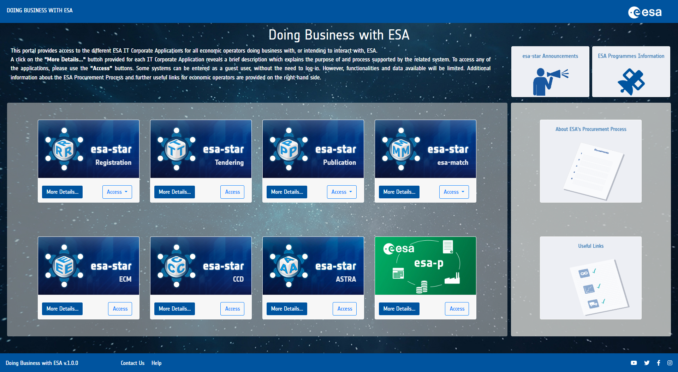
1. ESA Tools – Basics of ESA Procurement
https://doing-business.sso.esa.int/
Portal for access to the entire esa-star toolset, including associated ESA corporate applications like esa-p
All applications are connected, making it easier for users to access the systems and retrieve information
Optimised and supported for use with the Google Chrome browser

Slide 7

1. ESA Tools – Basics of ESA Procurement
esa-star Registration (https://esastar-emr.sso.esa.int/)
Registration on ESA-STAR is a pre-requisite to do business with ESA
esa-star Publication (http://doing-business.sso.esa.int)
All Tender related documents can be found in esa-star Publication. Here you request the system to create a Bidder Restricted Area in ESA-STAR Tendering
esa-star Tendering (http://doing-business.sso.esa.int)
In the Bidder Restricted Area, you can request for clarifications and submit the proposal
esa-star esa-match (https://esastar-esamatch.sso.esa.int/)
Competences & Capabilities, find suitable tenders and entities for collaboration
Instruction video
http://www.esa.int/spaceinvideos/Videos/2016/03/Bidder_Restricted_Area_creation_and_structure

Slide 8
1. ESA Tools – Basics of ESA Procurement
esa-star Registration
Register in ESA-STAR Registration

Slide 9
1. ESA Tools – Basics of ESA Procurement
esa-star Publication
Access Tenders and
ESA procurement related news

Slide 10
1. ESA Tools – Basics of ESA Procurement
esa-star Tendering (For activity types A, B, D, F, G1, G2)
Submit your proposal

Slide 11
1. ESA Tools – Basics of ESA Procurement
esa-star esa-match
Network, find partners, advertise what you offer

Slide 12

2. Overview Type of Activity and their respective call
CfP1
CfP2

Slide 13
2. Type of Activities and their respective call
The subject of the Calls for Proposals is exclusively for the following activity types:​
Call: CfP/5-50037/23/NL/MH | Call: CfP/5-50036/23/NL/MH
Type A – Research and preparatory activity​ | Type G2 - Education activities – PhD Theses
Type B – Flight and ground segment related research and development activities​
Type C - Flight Opportunities​ N/A
Type D - Space science activities​
Type E - Satellite development N/A
Type F - Space (downstream) Applications. ​
Type G1 - Education activities – University courses
​Type H – Space related courses Handled via OSIP (separate presentation)

