Slide 1
How to write good proposal
12/09/2023

Slide 2
Summary of the presentation
Disclaimer
Common Mistakes
The proposal template - Cover Letter
The proposal template Part 1 – Technical and Application part
The proposal template Part 2 – Management part
The proposal template Part 3 - Financial part
The proposal template Part 4 – Contract Conditions part

Slide 3
Disclaimer
This presentation material does not contain sufficient information to be used, in any way, in the context of any ESA ITTs (Invitation-to-Tender).
This presentation is just to help understand, in a simplified manner, some of the key elements associated with ESA proposals.
Proposal templates can vary, however, some main elements are provided in this presentation to serve as an example and guidance. Do not copy any part of the examples given.
Please ensure that your Proposal is compliant with the requirements contained in the specific ITT documentation.

Slide 4
Proposal Template (hints and tips)
During this presentation we will draw your attention to common mistakes and oversights in proposals. It is not a prescriptive ‘do it like this’ list and the material must be sensibly applied to your particular case.
There is no substitute for a good idea. This presentation will only help you to present your idea in a way it can be understood by reviewers.
Please ensure that your Proposal is compliant with the ITT conditions of tender and cover letter – each ITT can be different. Do not use a previous template from any other ITT.
REMEMBER:
ESA is only allowed to evaluate what is in the 25 pages of the proposal – do not assume that the reviewers have “your common knowledge” or that “it is commonly known”. We cannot evaluate intentions, “read in-between-the-lines” or guess what you mean. We are only allowed, outside of the proposal, to consult ESA-STAR or other ESA internal information.
The TEB members have to read typically 20+ proposals in total per TEB – the easier you make it for them to read and understand, the better for both them and you.

Slide 5

Proposal Template
Common Mistakes / Checklist before submission

Slide 6
Proposal Template – Common Mistakes
VERY BRIEF summary of SOME of the most common mistakes seen: NB! CHECK YOUR PROPOSAL AGAINST THIS LIST!
Criteria 1
Objectives difficult to understand or not clearly stated.
Poor or missing technical requirements (e.g. not covering the key points, not quantified or verifiable, not matching market need).
Poor or missing engineering approach (e.g. baseline concept not described, missing reviews or checks, lack of key testing or validation).
Poor or inadequate programme of work (e.g. missing customer involvement, missing design or development steps) and inconsistency between text, flowchart, WBS, WPD and GANTT.
Missing experience or facilities – no information on relevant work done by the company, no or poor relevant CVs for the key personnel, no (or poor) information on facilities and/or having no plan to acquire it.
Poor WPD (e.g. insufficient detail to understand the full scope of the work, no clear responsibilities, inputs and outputs of each WPD).
Poor WBS (e.g. spaghetti WBS and flowchart, too many/few WP, WP with tasks for more than one entity).
Criteria 2
Not meeting the programmatic constraints of the cover letter (e.g. not related to ESA needs or programmes, not space related, not credible start or target TRL, no clear benefit for the country, no user involvement in services and applications proposals).

Slide 7
Proposal Template – Common Mistakes
Criteria 3: Management, planning, costing parts
Poor management plan (e.g. missing how you will monitor the timely implementation of the activity, sub-contractor control, including a steering group or management ‘team’ instead of a Project Manager).
Poor planning (e.g. insufficient detail, no dependencies, too much in parallel, not matching scope of WPD).
Non-credible costing (e.g. hours not corresponding to described scope work in WPD, procurement of inappropriate items, excessive travel costs, price = max available envelope, procured items not detailed or justified). The goal is fair costing w.r.t. entities standard cost structure!
Poor definition of deliverables (e.g. missing deliverables, not covering the full scope of work, deliverables not matching WPD outputs).
High (>10%) / very low (<5%) management hours w.r.t. total hours.
Inconsistency between PSS forms and proposal (costed travels not in meeting plan, facilities/service costed for but not mentioned in proposal).
Criteria 4: Compliance with administrative tender conditions
Some of the documents not signed or missing (e.g. Cover Letter, PSS Forms).
Non compliance with tender conditions (e.g. Introducing changes to the Proposal Template or exceeding the maximum number of pages).
Disagreeing with the Draft Contract (that you accepted by signing the Cover Letter).
Leaving incomplete part of the essential information (e.g. milestone payments, deliverables, leaving empty the IPR section, management plan section or any other section – please fill it: if it is the case say that it does not apply and why).

Slide 8
Proposal Template – Cover Letter
Contains details on:
Title
The team submitting the proposal
Cost of the proposal
What type of activity (a, b, c, d, e, f, g or h)
Duration of the proposal
Who is the point of contact
Acceptance of contract conditions
Statement concerning export restrictions
Statement on free competition
Legal representative
Validity of the proposal
etc.
It MUST be signed
REMEMBER: By signing the cover letter you are accepting the contract conditions – so do not, in the proposal, state that you want to modify them.

Slide 9
Proposal Template – Title
Hints and tips: The Title
Each call may have many proposals. To aid reviewers, pay attention to the title of your proposal. It should prepare them for what they are about to read and clearly identify your proposal:
Keep it short
Keep it clear
Make it descriptive and relevant
Do not waste time to think up overly long titles or try to force acronyms for the project.
Examples
Simple and concise – but OK: “Increasing coffee sales by responding to customer demands”
Overly long and unnecessarily complex: “Investigating and testing various methods of maximising financial revenue and fiscal returns resulting from bean derived hot beverages sales in a customer focused environment using direct market feedback and other methods.”
Trying too hard for an acronym: “Cash maximising Objectives for increased Financial and Fiscal returns in a European Environment for HOt Beverages Sales (COFFEE HOBS)”

Slide 10

Proposal Template
Part 1 – Technical and Application Part

Slide 11
Proposal Template: Part 1 – Technical and Application Part
1.0 INTRODUCTION AND SCOPE
1.1 TECHNICAL OBJECTIVES
1.2 REQUIREMENTS
1.3 TECHNOLOGY READINESS LEVEL

Slide 12
Proposal Template: Part 1 – Technical and Application Part
1.0 INTRODUCTION AND SCOPE
Provide the background and rationale of what you are proposing to do. Keep it succinct (not more than half a page), but clear enough to provide sufficient context for your development.

Slide 13
Proposal Template: Part 1 – Technical and Application Part
1.1 TECHNICAL OBJECTIVES
The Objective is what you hope to achieve with the proposal (i.e. the end goal) and the key constraints or conditions under which that should be met. This is sometimes called the mission goal in texts. In theory, everything you propose to do should be derivable from this statement.
Objectives should:
  Be short (1 to 3 sentences)
  Be clear and verifiable
  Contain the core essence of what should be achieved
Objectives should not:
  Describe the work to be done, the work flow or how to do it
  Describe the nice to haves/ options
  Be overly long and descriptive
“‘…this nation should commit itself to achieving the goal, before this decade is out, of landing a man on the Moon and returning him safely to Earth” – this was the objective stated for a 24 Billion dollar project.
In ‘Application’ part of the proposal you should justify WHY this is a good objective and how it fits the programmatic constraints!

Slide 14
Proposal Template: Part 1 – Technical and Application Part
1.2 REQUIREMENTS
For proposals, requirements are the key measurable features that the product or the work must meet in order to be declared successful. They should take into account what the end user needs/considers important.
Requirements are:
Clear, verifiable, quantitative and measurable.
Requirements tell you what needs to be achieved / realized
Requirements are what we all use to measure if the objectives were achieved
Note: Ideally requirements will also be justified in the proposal.
Requirements are not:
The facilities, tools, experience or personnel that you need to perform the work.
If you are not in a position to properly define a full set of clear, well formulated requirements then consider to either look at a preparatory activity or include an activity focused on requirement definition and include a work package to this end.

Slide 15

Proposal Template: Part 1 – Technical and Application Part
Example (in a cafeteria):
Well formulated requirements:
The coffee shall be served at a temperature between 85 and 90˚C.
The coffee shall be delivered to the customer within 4 minutes of being ordered.
The coffee shall be dispensed in 200ml +/- 10ml servings.
The customer shall receive a biscuit with each coffee, included in the price of the coffee
Poorly formulated requirements:
The coffee has to be a good temperature
The coffee must be served quickly
The coffee shall have big serving sizes
We want people to have biscuits with their coffee
Not a requirement at all in this sense:
We need to buy a kettle and coffee cups
We need to hire someone to make the coffee
We should do a trade off on what biscuits to give
We shall get a coffee sellers license

Slide 16
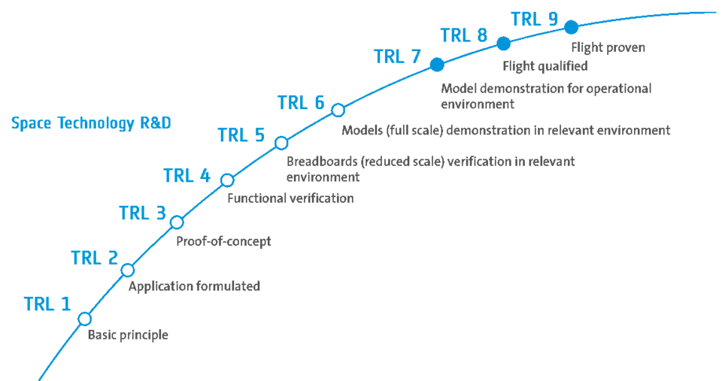
Proposal Template: Part 1 – Technical and Application Part
1.3 TECHNOLOGY READINESS LEVEL
Indicate and substantiate the current TRL level of the technology.
Refer to Annex A to the ITT Cover Letter for the description of TRLs.
Please note that the type of activity proposed, Type a, b or c has to be compatible with the start and end TRL indicated in the Cover Letter of the call.

Slide 17
Proposal Template: Part 1 – Technical and Application Part
1.4 ENGINEERING APPROACH
1.4.1 State of the Art
1.4.2 Technical Steps
1.4.3 Proposed Work Logic
1.4.4 Implementation aspects
NB! This is expected to be the core/bulk of the proposal

Slide 18
Proposal Template: Part 1 – Technical and Application Part
1.4 ENGINEERING APPROACH
1.4.1 State of the Art
Provide a brief overview of “State of the Art”.
Explain why you chose your proposed baseline instead of others, what benefit does it have over the others?
1.4.2 Technical Steps
Present and discuss in DETAIL the scientific/technical steps to achieve the set objectives.
This needs to correspond to the Work Flow Logic! This is the text description and justification of the flow chart and the Work Breakdown Structure.

Slide 19
Proposal Template: Part 1 – Technical and Application Part
1.4 ENGINEERING APPROACH
1.4.3 Proposed Work Logic
Include the reviews and decision points (check points). Technical ECSS reviews are key for credibility and typically align with payments.
Consistency with WBS (and easy traceability)
Parallel/serial consistency is logical (consistent with GANTT chart)
Sub-contractor work is clear
Dependencies clear

Slide 20
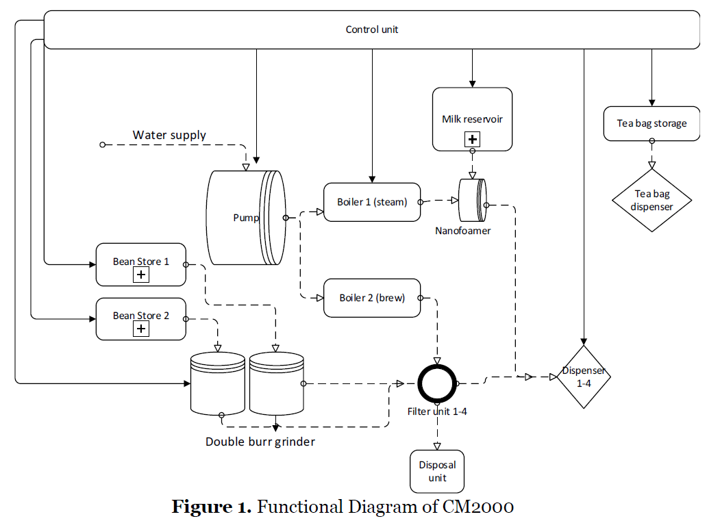
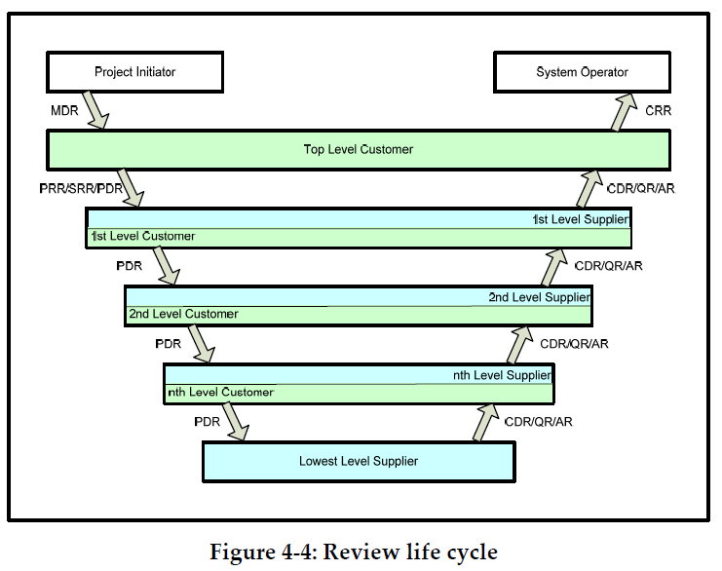
Proposal Template: Part 1 – Technical and Application Part
1.4 ENGINEERING APPROACH
1.4.4 Implementation aspects
NB! Present a first iteration of the baseline design or concept (diagram)!
Have you answered these questions?
What are the key stages/ steps in the work/activity?
What is the goal/ purpose of each step?
What will be done in each step?
How will each step be assessed, controlled, reviewed or validated?
How does each step relate to the others?
If there are subcontractors: How is the work broken up between companies? Why?
What are the key trade offs? What are the key decision points?

Slide 21
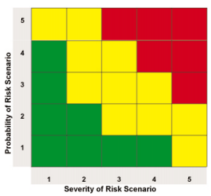
Proposal Template: Part 1 – Technical and Application Part
1.5 TECHNICAL FEASIBILITY, PROBLEM AREAS AND DEVELOPMENT RISK
The problem areas and risks discussions are intended to cover primarily TECHNICAL (and PROGRAMMATIC where there is a key dependency/ timeliness issue), problem areas and risks that may arise DURING the work and cannot be pre-emptively resolved prior to the start of work.
Correct identification of risks and potential problems shows you understand the work you are proposing and can manage it properly.
Discussion of risks and problems should include a mitigation and prevention actions:
What is the potential impact if the problem/risk arises?
Prevention: What actions will you take to minimize the risk of it becoming a reality?
Mitigation: What will you do if the worst case happens, how will you ensure the project can continue (can it?)?
Provide details to show those mitigating actions are credible and feasible.
DO NOT focus on manpower issue, management issues
DO include technical issues, risks and problems
DO include planning issues related to critical path items

Slide 22
Proposal Template: Part 1 – Technical and Application Part
1.6 PROSPECT FOR EXPLOITATION AND USE
This is very strongly linked to the objectives and the requirements (in particular the user requirements).
Who will use the technology developed?
What will they use it for?
Why is it needed?
What are the competing technologies/ methods?
Why could this be better?
Is there a valid business case for continuing after this activity?
Does it match the programmatic constraints of the call? (BE EXPLICIT WRT COVER LETTER)
If you don’t know the answers to all these and can’t convince us then why should we finance the development? Think about a preparatory activity.

Slide 23

Proposal Template: Part 1 – Technical and Application Part
1.7 TECHNICAL IMPLEMENTATION / PROGRAMME OF WORK
1.7.1 Work Breakdown Structure (WBS)
1.7.2 Work Package Description (WPD)
TIP! These sections should be coherent with the earlier sections of the proposal!

Slide 24
Proposal Template: Part 1 – Technical and Application Part
1.7.1 Work Breakdown Structure (WBS)
Logically structure the main Work Packages following the main tasks of the work flow (preferably ‘gated’ by reviews)
  Work logic is preferably ‘gated’ by technical / engineering reviews
    Preliminary Requirements Review (PRR), System Requirements Review (SRR), Preliminary Design Review (PDR), etc. These typically are aligned with payment milestones.
    See ECSS-M-ST-10C Project Planning and Implementation (Chapter 4,5 and Annex A) for standard review definitions.
Include WP for management
Ensure each company has separate (sub)work packages
Ensure all tasks in one work package ‘belong together’

Slide 25
Proposal Template: Part 1 – Technical and Application Part
1.7.1 Work Breakdown Structure (WBS)
No Management
No split by company
Not organised by core Task/Phase (WP307 is major WP not sub-WP)
Insufficient detail in WP500 for Planning
✗
✓
Management is partly clear w.r.t. entities, but work package leaders aren’t shown and require cross referencing
Clear split by company and management of subcontractor is implied. Color coding by company / entity is good
WP400 is significant with necessary subordinate WPs.
WP500 Subordinate WPs give fair indications core tasks & credible planning

Slide 26
Proposal Template: Part 1 – Technical and Application Part
1.7.2 Work Package Description (WPD)
  The WPDs form the detailed description of the work that will be performed
  They scope the work and the deliverables
  They allow a basis for the costing
  They discriminate the work and responsibilities of the different companies/ entities
Note that the ECSS propose a standard template for a WBS and WPD (for the WPD the ESA PSS A20 form can be used)

Slide 27
Proposal Template: Part 1 – Technical and Application Part
Essential Data:
  Work Package (WP) Title, WP Manager, Company
  Start and end dates (T0+) and/or EVENT (PDR, CDR)
  Inputs
  Description of work (e.g.: tasks and sub-task)
  Outputs (each WP will result in a number of technical documents, for example output of WP1 (task 1.1 and task 1.2), there will be TN1.1 and TN1.2
TIPS:
  WP Manager should be responsible for the work (e.g. have suitable experience)
  Duration (Start: T0 + 1, End: T0 +5).
  Describe work (bullets) at sufficient detail to understand level of analysis performed, work flow within the WP, reviews to be held etc. Avoid generic ambiguous high level descriptions (e.g. ‘Perform design’)
  Outputs are all deliverables produced, ensure consistency with Deliverables list and deliverable identifiers.

Slide 28
Proposal Template: Part 1 – Technical and Application Part
Note: The outputs to the Work Package Descriptions shall be included in the List of Deliverables!
Bad
Good
Too high level
Too open to interpretation
Scope undefined
Deliverable undefined
Company missing
No inputs
Actual dates used
Not linked to planning (events)

Slide 29
Proposal Template: Part 1 – Technical and Application Part
1.8 Background of the company(ies)
We are only interested in RELEVANT background and experience.
Coffee Example:
Directly relevant experience for a Coffee maker: Having made coffee before for themselves or having made multiple types of coffee in a café
Partially relevant experience for a Coffee maker: Having made other (non-coffee) hot beverages, having worked in a café where coffee was made, but not actually making the coffee.
Non-relevant experience for a Coffee maker: Cleaning the café, playing football, driving a car
Do not waste space in the proposal with non-relevant experience.
Relevant patents, papers or publications could be included in Annex(es)
If the people or bidding team is missing key background, experience or knowledge – identify this yourself and explain how you will get it.

Slide 30
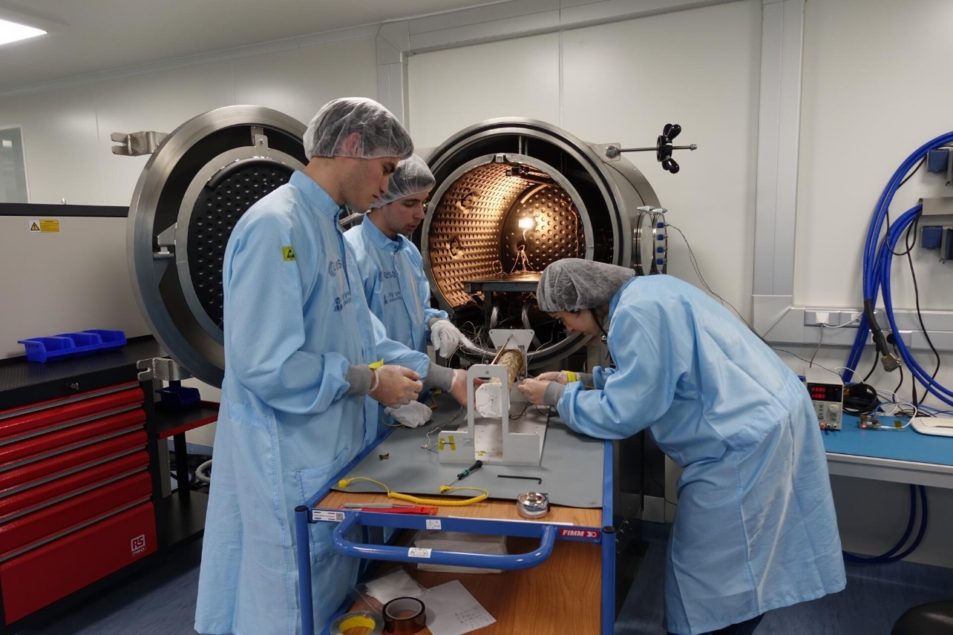
Proposal Template: Part 1 – Technical and Application Part
1.9 Facilities
Facilities are the things needed in order to complete the work proposed. You need to identify what you need for the proposed work and whether you have it, or how you gain access to it.
Example Facilities
  Test equipment
  Specialist design and analysis software
  Specialist computing facilities
  Specialist manufacturing facilities
Examples of things NOT considered Facilities:
  Your building and address
  Your car park
  Your desks and office furniture
  Standard computers, office s/w and printers

Slide 31

Proposal Template
Part 2 – Management

Slide 32
Proposal Template: Part 2 – Management Part
2.1 TEAM ORGANISATION AND PERSONNEL
2.1.1 Proposed team
2.1.1.1 Overall team composition, key personnel
Provide an organigram that describes the overall team composition, including participants from all Sub-contractors, if any, and including all key (i.e. having a major role within the team and/or being responsible for one or more WPs) personnel.

Slide 33
Proposal Template: Part 2 – Management Part
NB! Key Personnel
A Key Personnel is someone playing a leading role in the activity OR providing irreplaceable experience and expertise.
Anyone contributing <<10% of their time is being used very inefficiently and is by definition not playing a leading role (unless due to unique expertise).
If someone is claimed to be a key personnel because they have irreplaceable experience and expertise – explain the role they play, what this is and how it will be exploited.
High numbers of claimed key Personnel does not make the proposal any better. Demonstrated good and effective use of people with the right background and with clear roles is better.
The percentage of the working time that each key personnel will dedicate to each Work-package (WP) shall be given. For the management task, if the consortium is not large, the percentage should not be higher than ~10%.

Slide 34
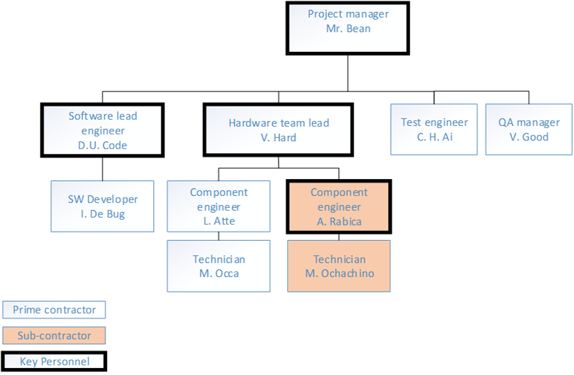
Proposal Template: Part 2 – Management Part
2.1.1.1 Overall team composition, key personnel
Provide an organigramme for the Project Team (including sub-contractor(s), if any), this is intended to show the reporting lines and responsibility/delegation. It does not show who talks to whom on a daily basis.
Each sub-contractor should have 1 formal contact point
NO steering committees in ESA contracts – Project Manager (in discussion with ESA) is responsible for the direction, quality of work, decisions and timeliness.
✗
✓

Slide 35
Proposal Template: Part 2 – Management Part
2.1.1.2 Rationale of the proposed industrial organisation
Rationale of the team composition
Rationale of the split of work between Prime and subcontractor(s) (if any)
Justification for the choice of subcontractor(s) (if any)
2.1.1.3 Position of each of the team members within his/her own company’s (or institute’s) structure and within the proposed team
Clear and short description (not WP responsibility only)
2.1.1.4 Time dedication of key personnel
Check consistency with PSS Forms

Slide 36
Proposal Template: Part 2 – Management Part
2.2 Curricula Vitae
  One summary resume per key person
  Include:
  Role
  Relevant experience
  Very summarised version of other experience
  Full CV can be included in an Annex

Slide 37

Proposal Template: Part 2 – Management Part
2.3 Management of Subcontractor(s)
Most space developments require multidisciplinary International teams.
In cases where you involve of Subcontractor(s), present the management plan and procedures to exercise monitoring and control over the contributions from subcontractor(s) (e.g., progress meetings, reports, supplier reviews).

Slide 38
Proposal Template: Part 2 – Management Part
2.4 PLANNING
2.4.1 GANTT chart
2.4.2 Proposed Schedule
2.4.3 Meeting and Travel Plan

Slide 39
Proposal Template: Part 2 – Management Part
2.4.1 GANTT chart
The GANTT chart shows you can organise your work, provides a tool to monitor the work, to communicate key dates and to show what drives the schedule.
It shows you understand the work involved in what you are proposing.
Some tips for GANTT charts:
It should link clearly to WBS and Flow Chart
It should show milestones, reviews and key deliverables
It should show the key dependencies between tasks
Include to a ‘sensible’ level (not too much, not too little) – ask can you monitor progress?
Is there a critical path? Is it shown and discussed?

Slide 40
Proposal Template: Part 2 – Management Part
Bad GANTT chart
No dependencies or critical path shown
No discrimination between entities
No meetings/ key points
Names not matching WBS titles
Insufficient granularity (not matching WBS)

Slide 41
Proposal Template: Part 2 – Management Part
Good GANTT chart

Slide 42
Proposal Template: Part 2 – Management Part
2.4.2 Proposed Schedule
Provide a synthetic summary of the schedule including duration, planning assumptions (e.g. envisaged start date, holidays etc.) and identifying and explaining key planning drivers and dependencies.
2.4.3 Meeting and Travel Plan
Should be consistent with the cost given in PSS A2, Exhibit B and shall include not only meetings with the Agency but also meetings with sub-contractors involving travel, field trips, travels to test houses.
All meetings with ESA (e.g. progress meetings – note these may be via telecon)
All reviews, both internal and with ESA (e.g. Requirements Reviews, Design Review, Test Readiness...)
All meetings with sub-contractors or potential customers (e.g. progress meetings, working meetings, requirement definition meetings)
All travels to facilities (e.g. Test houses, Ground truth measurement areas)
Final Presentation (at ESA premises)
NOT to include:
Any meeting or travel not DIRECTLY needed for progression of the activity (e.g. conferences, promotional activities…)
Ad-hoc meetings to resolve problems (e.g. supply problems)

Slide 43
Proposal Template: Part 2 – Management Part
2.5 DELIVERABLE ITEMS
The List of Deliverable Items shall be grouped in Documentation, Hardware and Software and shall include sufficient explanation to unambiguously represent the scope of the deliverable.
2.5.1 Documentation
  Ensure there is a description of each deliverable to avoid later discussion!
  Ensure consistency with WPDs!
2.5.2 Other Deliverables (Hardware, Software, Models, Data, etc.)

Slide 44



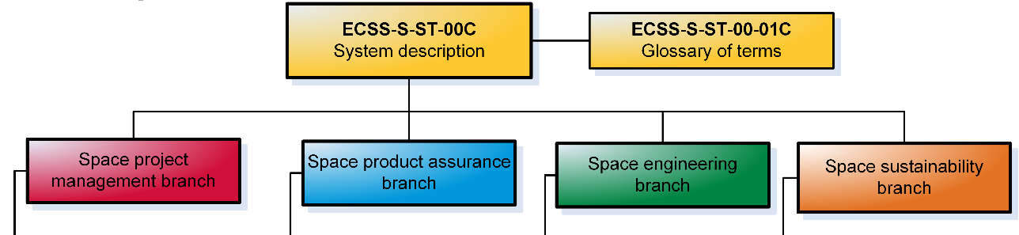
Proposal Template: Part 2 – Management Part
ESA implements the European Cooperation for Space Standardization (ECSS) in it’s programs. This implementation is for RPA projects, but it is strongly recommended to implement them at least partially to better understand the way ESA programs work and the terminology used and resulting requirements.
ECSS documentation is available for free download from www.ECSS.nl. Registration is free.
Some key documents to start with are:
ECSS-M-ST-10C Project Planning and Implementation (In particular, Chapter 4,5 and Annex A)
ECSS-M-ST-80C Risk Management
ECSS-E-10A System Engineering
ECSS-E-ST-10-06C Technical Requirements Specification
ECSS-Q-ST-20C Space Product Assurance - Quality Assurance

Slide 45

Proposal Template
Part 3 – Financial Part

Slide 46
Proposal Template: Part 3 – Financial Part
3.1 PRICE QUOTATION FOR THE CONTEMPLATED CONTRACT:
[Enter here the total amount quoted as a Firm Fixed Price (FFP), in Euro without cents, delivery duty paid, exclusive of import duties and value added taxes in ESA Member States, etc., in pursuance of the pricing conditions fixed in the “Draft Contract” included in the ITT]
Remarks concerning certain price elements:
a) Charging of royalties and licence fees:
ESA will only accept to pay royalties or licence fees on the condition that they are:
- clearly identified in the tender, with the financial basis for their calculation, method of application and total amount, and
- demonstrated to be of direct and necessary benefit to the work to be performed (thus not merely the consequence of a general agreement or commitment to a Third Party), and
- applied only to that part of the effort to be performed by a Contractor or Sub-contractor that is directly related to the subject matter of the licence or royalty agreement.

Slide 47
Proposal Template: Part 3 – Financial Part
(cont.)
3.1 PRICE QUOTATION FOR THE CONTEMPLATED CONTRACT:
Remarks concerning certain price elements:
b) Quotations free of taxes and custom duties:
Prices shall be quoted free of any value added taxes (VAT) and import duties in the Agency’s Member States. Please note that subcontractor are not VAT exempt. In this connection you shall pay attention to the provisions stated in Article 3 of the Draft Contract (Appendix 1 to the ITT). In case you consider that you and/or your Sub-contractor(s) will remain subject to payment of taxes or custom duties, you shall indicate separately the applicable rates, the corresponding estimated amounts, and the reason why exemption from such taxes or duties cannot be obtained.
c) Currency and conversion rate:
For any Tenderer or proposed Sub-contractor located in countries outside of the Euro zone, the exchange rate used to quote their prices in Euro shall be indicated by the company (or institute) in its costing form PSS-A2. Any other factors (such as hedging costs, forward buying rates) used for the purpose of the calculations shall also be indicated]

Slide 48
Proposal Template: Part 3 – Financial Part
Hints and tips: Price Quotation
The price of the Contract will be a Firm Fixed Price without VAT.
The EU provides International Organisations the privilege to be exempted from VAT for intra-community transactions. ESA, as an International Organisation, is classified as non-taxable. ESA applies this privilege by issuing a VAT EXEMPTION CERTIFICATE for its contract. ESA does therefore not have a EU VAT-ID number
=> The VAT Exemption certificate will be provided with the original contract.
The Prime Contractor is the only one receiving the VAT EXEMPTION CERTIFICATE as it is the supplier in direct contractual relationship with ESA. It is the Prime Contractor to invoice ESA directly.
Sub-contractors will not receive the VAT EXCEMPTION CERTIFICATE as they do not stand in a direct contractual relationship with ESA; they are paid by the Prime.

Slide 49
Proposal Template: Part 3 – Financial Part
Hints and tips: Price Quotation
2. The price of the proposed activity must be transparent, clear and credible.
TRANSPARENT: Where does the money go? (e.g: the cost structure, hardware etc.)
CLEAR: Level of details is important => PSS forms
CREDIBLE: Are the cost credible to achieve the objectives of the proposed activity ?
After the contract is signed by both party, ESA does not require financial reporting on the evolution of the spending.
All financial details are set in the proposal & at negotiation. The proposal and the minutes of meeting will be part of “the rules of the game” together with the Contract for the all duration of the contract.
The financial envelope in the ITT is an earmarked budget – it is NOT a goal. Price must be fair and reasonable for the scope of work described in the proposal.

Slide 50
Proposal Template: Part 3 – Financial Part
3.2 DETAILED PRICE BREAKDOWN
3.2.1 Procedures Specifications and Standards (PSS) costing forms:
[On the basis of the corresponding instructions to each form, complete and insert in Annex to your Proposal the costing form(s) requested below):
PSS A1 Company Cost Rates and Overheads
PSS A2 Company Price Breakdown Form
PSS A2 Exhibit A – Other Cost Element Details (if applicable)
PSS A2 Exhibit B – Travel and subsistence plan
PSS A8 Manpower & Price Summary per WP
Note that the PSS form templates can be downloaded from esa-star Publication at https://esastar-publication.sso.esa.int/supportingDocumentation under Reference Documentation/Administrative Documents/PSS Forms/Issue 5. Each of the PSS forms must be signed.
Note for co-funded activity, the PSSA2, Exhibit A and Exhibit B and PSSA8 should present the total cost of the activity including the co-funded amount. No profit can be charged on co-funded activity. The amount co-funded by the Tenderer shall not include any additional co-financing from other public R&D or other public programmes. The difference between the total cost of the activity and the total price of the present Contract shall be funded by the Contractor through [its internal funds/ or specify as required], and shall not be recharged to the Agency in other Contracts, nor in the form of overhead.
For fully funded activity, the profit shall not exceed eight percent (8%) of the base cost defined in item no. 9 of PSS A2 form, issue 5 (“Company Price Breakdown Form”).

Slide 51
Proposal Template: Part 3 – Financial Part
Procedures Specifications and Standards (PSS)
PSS A1 Company Cost Rates and Overheads
PSS A2 Company Price Breakdown Form
PSS A2 Exhibit A – Other Cost Element Details (if applicable)
PSS A2 Exhibit B – Travel and subsistence plan
PSS A8 Manpower & Price Summary per WP

Slide 52
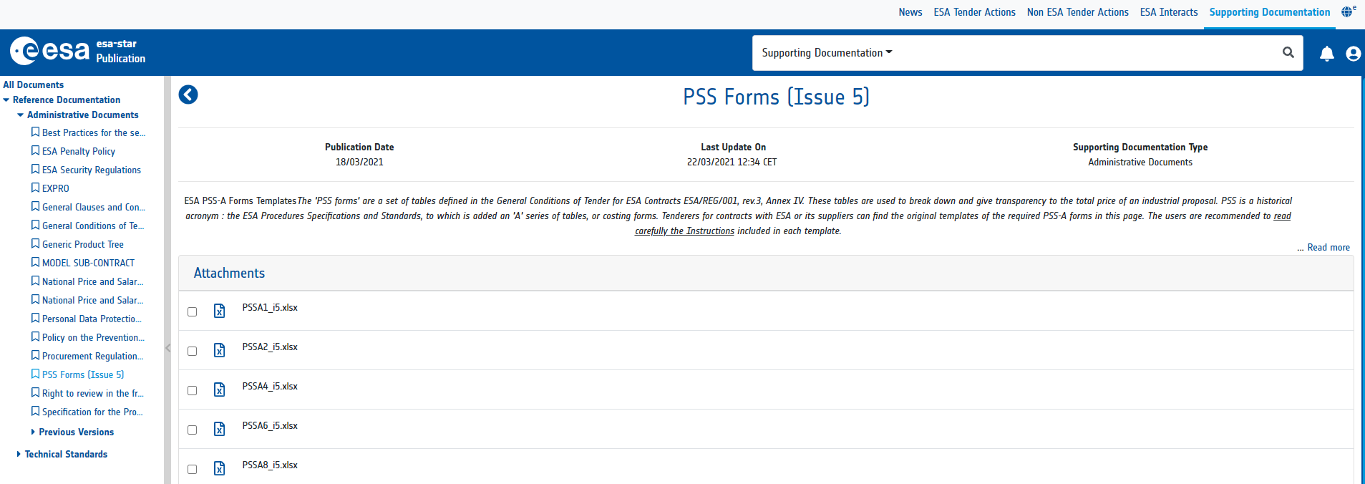
Proposal Template: Part 3 – Financial Part
How to retrieve PSS forms?
Step 1
Step 2
Step 2

Slide 53
Proposal Template: Part 3 – Financial Part
Why do we use PSS Forms ?
Fairness: PSSs are standard tools used for all ESA activities/ITT. All costs are presented the same way to allow systematic evaluation.
  Clarity: PSSs allow to review clearly where the money is allocated.
  Evaluation tool: e.g number of hours spent per key personnel per Work Package, cost per category, hardware cost…
Check carefully the Instruction Page
BE AWARE: We evaluate in detail the cost. We will challenge the number of hours and the cost allocation to verify that the cost are true and credible. Use the standard cost categories effective for any other work done by your organisation.

Slide 54
Proposal Template: Part 3 – Financial Part
PSSA1
Present the labour Cost per Category (Project Manager, Mechanical Engineer, Senior scientist, PhD, Engineer …)
No Names
ONE hourly rate for ONE labour cost category
Fill in the Internal Facilities' part only if cost will be allocated to it.

Slide 55
Proposal Template: Part 3 – Financial Part
PSSA2
Full vision of the cost allocated to the activity
If applicable, do not forget to include profit and cost of subcontractors
Exhibit A : Details the cost allocated to hardware, services and miscellaneous
  TIPS: Cost must be detailed and verifiable against current market price
Exhibit B: Details the travel costs
  No conference unless strictly linked to the need of the activity. We promote teleconference whenever possible. Not everyone need to come to the Final Presentation.
The instruction provides all the definitions related to OTHER DIRECT COST ELEMENTS.

Slide 56
Proposal Template: Part 3 – Financial Part
Hints and tips: PSS A2
Key review points by
Technical Experts
Total # hours
Total # FTE
Are these reasonable for the duration and scope of work?
Do they match the # and time allocation of key people?

Slide 57
Proposal Template: Part 3 – Financial Part
Hints and tips: PSS A2
Key review points by
Technical Experts
Other direct cost elements - % of overall cost reasonable? (details reviewed in Exhibits)
Profit <= 8%?
Costing should be done from the bottom up. A reduction can be offered, if the budget exceeds the financial envelope for the activity type.
Total – less than earmarked budget?

Slide 58
Proposal Template: Part 3 – Financial Part
Hints and tips: PSS A2 Exhibit A
Key review points by
Technical Experts
Bought in items
Justified by scope of work?
Not representing infrastructure?
Not representing ‘normal work’ items?
Sufficiently identified?
Reasonable cost?
External Services
Clearly described?
Clearly needed?
Value for money?
Referenced in the proposal?

Slide 59
Proposal Template: Part 3 – Financial Part
Hints and tips: PSS A2 Exhibit B
Key review points by
Technical Experts
Meetings:
Matching meeting plan?
All clearly justified?
# People:
Matched to scope of meeting?
Travels:
Flight costs reasonable?
#days reasonable?
Subsistence reasonable? (often too low)

Slide 60
Proposal Template: Part 3 – Financial Part
PSSA8
Cost and Hours are broken down per Work Package
We evaluate whether there is too much, not enough hours allocated to each WP
Consistency of information is important
Do not forget to sign the PSS forms
Do not forget the total!

Slide 61
Proposal Template: Part 3 – Financial Part
Hints and tips: PSS A8
Key review points by
Technical Experts
Hours per work package
Matching/ reasonable for scope of work described in WP?
Reasonable spread of hours (i.e. focus at key part)?
Hours spent on management reasonable?
Is the PSS complete? (Often not fully filled out)
Procurements associated to correct WP?

Slide 62
Proposal Template: Part 3 – Financial Part
  PLEASE NOTE!
  All fields in National Currency and in EURO must be filled in.
  Please do not forget to fill in the exchange rate.
  For non-profit organizations, no profit can be accepted. For other organisations, the profit shall not exceed 8% of the Total Company Cost shown on line 8, which excludes the base value of 3.5b. Subcontractor prices are not considered to be own company cost and, being already inclusive of profit, are shown on line 13 of the PSS A2 (Issue 5).
  Final presentation shall take place at the Agency's premises. The cost of attendance/participation to conferences can only be covered if it is directly pertinent to the work being proposed, and shall be justified.
  Overheads on procurements and labour rates are intended to cover admin costs and general office supplies and overheads.

Slide 63
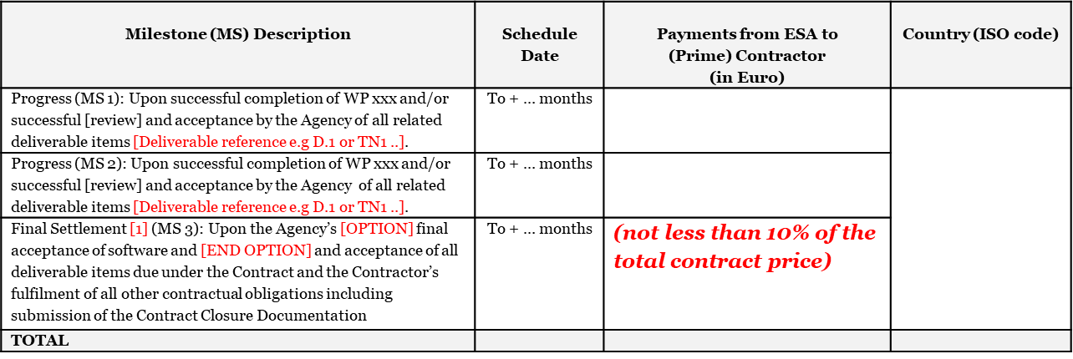
Proposal Template: Part 3 – Financial Part
3.3.2 Milestone Payment Plan
Determines how much gets paid, when and what are the conditions for payment
ESA pays against achieved results = Payment milestone dates typical align with technical review
milestones successfully concluding with all associated deliverables accepted by the Agency.

Slide 64
Proposal Template: Part 3 – Financial Part
Hints and tips:
Not more than 2 payments in a 12 month period!
Balance to be cash neutral!
Acceptable Milestone Description
Preferred description is linked to a review
Payments should be balanced to predicted expenditure profile
Milestone (MS) Description | Schedule Date | Payments from ESA to (Prime) Contractor (in Euro) | Country (ISO code)
Progress (MS 1): Upon successful completion of the Requirements Review and acceptance of deliverables D1a, D1b, D1c, D2 and D3. | To + 2 months | 75,000 | EE
Progress (MS 2): Upon successful completion of the Preliminary Design Review and acceptance of deliverables D4a-c, D5, D6a-b, D7. | To + 7 months | 74,570
Final Settlement (MS3): Upon successful completion of the CDR and the Agency’s acceptance of all deliverable items due under the Contract and the Contractor’s fulfilment of all other contractual obligations including submission of the Contract Closure Documentation. | To +18 months | 41,812
TOTAL |  | 191,382

Slide 65
Proposal Template: Part 3 – Financial Part
Hints and tips:
SME status is sufficient justification for automatic 35% AP!
All non-SMEs must provide clear justification for </= 10% AP!
Note: The advance payment constitutes a debt of the Contractor to the Agency until it has been offset against a subsequent milestone.
Prime (P) | Company Name | ESA Entity Code (at contract signature) | Country (ISO code) | Advance Payment (in Euro) | Offset against | Offset by Euro | Condition for release of the Advance Payment
P |  |  |  | Amount (not more than 35% of the total contract price for SMEs and not more than 10% for non-SMEs) | MS 1 | Amount | Upon signature of the Contract by both Parties
In this case the 66,984€ would be paid on contract signature. At the first milestone (75K) on a further 8,016€ would actually be transferred
Prime (P) | Company Name | ESA Entity Code (at contract signature) | Country (ISO code) | Advance Payment (in Euro) | Offset against | Offset by Euro | Condition for release of the Advance Payment
P | HiQ Beverages Ltd |  | EE | 66,984 | MS 1 | 66,984 | Upon signature of the Contract by both Parties

Slide 66
Proposal Template: Part 3 – Financial Part
You are requested to indicate for information purposes only, the Milestone Payment Plan that is envisaged for Sub-contractor(s)
For Information purposes only : Amounts in Euro for Contractor and Sub-contractor(s)
Milestone | Prime Contractor HiQ Beverages Ltd | Insert Country (ISO code) EE | Sub-contractor A Under Pressure Manufacturing Ltd | Insert Country (ISO code) LV
Advance | 61,984 |  | 5,000
MS-1 | 8,016 |  | 0
MS-2 | 55,600 |  | 18,970
MS-3 | 41,812 |  | 0
TOTAL | 167,412 |  | 23,970
See page 32 of example proposal

Slide 67
Proposal Template: Part 3 – Financial Part
  PLEASE NOTE!
  All claims for payment shall be linked to the achievement of defined schedule milestones. These milestones are to be in the form of significant events in the programme to be selected on the basis of providing a check point for progress in the work performed. E.G.
  - Successful completion of Reviews
  - Acceptance of deliverables
  Progress reports are not sufficient to make payments
  Advance payments to be made after contract signature, may be agreed in line with:
  The Advance payment constitutes a debt of the Contractor to the Agency until it has been set-off against a subsequent milestone. The advance payment shall nominally be set-off against the 1st progress payment.
  Advance payments for SMEs are 35% of the contract price. SMEs are classified according to the criteria of the European Commission (Recommendation 2003/361/EC of 6 May 2003 (OJ L 124, 20.5.2003, p. 36)).
  The final payment milestone shall not be less than 10% of the contract price.

Slide 68
Proposal Template: Part 3 – Financial Part
3.3 COST TO COMPLETION
A cost to completion would be positive for all activities with a completion TRL of 6 or less (not necessary for education activities). This information is provided for information only and is not binding in any way for either party (ESA or Tenderer).
3.3.1 Further steps/ Activities needed to complete the development
Identify each of the main development steps / activities that would be needed AFTER COMPLETION OF THIS ACTIVITY to progress the work to higher TRL - if applicable.
    3.3.2 Estimated Cost per step
Provide a rough estimate of the expected cost of each further step or activity that would be needed in order to reach higher TRL (two levels above the final TRL achieved during the proposed work) – if applicable.
Further Step/ Activity | Estimated cost (Euro) | Estimated Start date | Estimated end date

Slide 69

Proposal Template
Part 4 – Contract Conditions

Slide 70
Proposal Template: Part 4 – Contract Conditions Part
4.1 INTELLECTUAL PROPERTY RIGHTS
4.1.1 Background Intellectual Property and Third Party Intellectual Property Rights
4.1.2 Foreground Intellectual Property
4.1.3 Ownership of Foreground Intellectual Property

Slide 71
Proposal Template: Part 4 – Contract Conditions Part
Background IPR
  Intellectual property existing already BEFORE the ITT.
  That is USED for the work of the ITT
  That had no ESA financial aid to develop.
  Must be listed, must be able to be evidenced (e.g. via patent, notebook or other means)
  Impact on the deliverables must be described
    Which deliverables is it included in?
    How does it affect that deliverable and ESA’s rights?
Foreground IPR
  Intellectual property developed DURING the Activity
  IP shall remain vested in the company
  ESA shall also have rights
  It shall not affect the deliverables/ rights on the deliverables
Hints and tips:
Foreground IPR is typically expected out of any technical development. FIPR contributes to advancement of products and services and commercial business cases.

Slide 72
Proposal Template: Part 4 – Contract Conditions Part
4.1.2 Foreground Intellectual Property
Present the expected FIPR that will be created as a result of the activity.
4.1.3 Ownership of Foreground Intellectual Property
[Please review carefully Articles 6 of the Draft Contract. Please provide two statements of compliance:
1/ the Contractor will own all Intellectual Property Rights and have the right to apply for, and to own, any
Registered Intellectual Property Rights arising from Work performed under this Contract in line with the clause
Articles 6.2.1 the draft Contract and
2/ the Agency shall have an irrevocable right to use the information used in that application, for its own
requirements on the terms set out in Article 6.2.2 the draft Contract.]
In the case of the participation of Sub-contractor(s), explain the agreement reached between the parties on the
ownership of the Intellectual Property and the principles for its exploitation, use and benefits.]

Slide 73
Proposal Template: Part 4 – Contract Conditions Part
4.2 IMPORT AND EXPORT LICENCES
This section is only to be completed in case of items or services that are subject to envisaged or probable inclusion of import/export restrictions, other than those from the Tenderer’s own country, in either the body of the work performed under this activity or in a resulting product or service.
4.2.1 Import and Export Licences applicable to this Activity
[SELECT ONE OF THE TWO OPTIONS]
[OPTION1]
The Tenderer declares that no items subject to import or export control will be used in the execution of this activity.
[OPTION2]
The Tenderer declares that the following items, subject to import or export control will be used in the execution of this activity:
Item | Control Type and Country of Origin | Deliverable affected | Comment

Slide 74
Proposal Template: Part 4 – Contract Conditions Part
(Cont.)
4.2 IMPORT AND EXPORT LICENCES
4.2.2 Import and Export Licences applicable to a product or services arising from or resulting from this Activity
SELECT ONE OF THE TWO OPTIONS
[OPTION1]
The Tenderer declares that any products or services arising from or resulting from this activity will not be subject to import or export control or make use of any import/ export controlled items.
[OPTION2]
The Tenderer declares that the following items, subject to import or export control, are expected to be used in an end product or service eventually arising from or resulting from this activity.
Item | Control Type and Country of Origin | Deliverable affected | Comment

Slide 75
Security Measures applied to submitted Tenders
DISTRIBUTION
TEB participants are granted access, in esa-star, to admitted tenders only after signing a Non-Disclosure and Non-Interest Form
SECURITY
DISPOSAL
Tenders not admitted for evaluation and those not recommended for contract award, are deleted from the esa-star system.
The latest ESA Security Directives are applicable to the procurement process and the admitted tenders.
Notes:
of Non-Disclosure and Non-Interest Form signed by all TEB members. That means that - The content of the Proposals are protected and are treated with strict confidentiality. Proposals and documents submitted by bidders in the frame of the procurement process are handled in accordance with the marking ESA UNCLASSIFIED – Limited Distribution in accordance with the ESA Security Directives.

Slide 76


Questions?
You made it!
Feel free to contact:
Email: Karol.Brzostowski@ext.esa.int Phone: +31 6 4845 6263

Slide 77
You made it! Questions?
Contact: Karol.Brzostowski@esa.int

