Slide 1

OSIP Platform – Activity Type H – Space related courses (Company employee training)
CfP/5-50037/23/NL/MH
Kim Johnson
Riga, 12/09/2023
Notes:
NO ACADEMIA, ONLY INDUSTRY

Slide 2

Introduction
In this presentation we try to explain the process for H activities
Proposals for Activity Type H (CfP/5-50037/23/NL/MH) are submitted through OSIP platform
It is a MUCH simpler process and you need to provide MUCH less information
DO NOT use the proposal template in ESA STAR for these Activity Types
These activity Types DO NOT count towards your proposal submission limits
  E.g. a company can submit 2 type A and 1 type H activity
Company can cover a max of 10,000 EUR, ESA 40,000 EUR

Slide 3
Open Space Innovation Platform (OSIP)
Ideas can be submitted in response to either a campaign or a channel
Due to their nature, Latvia RPA activities type H are implemented via OSIP
OSIP contains all information related to H activities process, special conditions and evaluation criteria
You need to register in OSIP to be able to see the active campaign AND you must register in esa-STAR (light registration) if you intend to submit your idea for activity type H in OSIP
OSIP is an ESA platform for submission of novel ideas for space technology and applications
The campaign will be open in OSIP at the same time of the LVR4 RPA call in esa-STAR, i.e.:
Opening on 19 September 2023
Closing on 31 October 2023
Notes:
Type h bit different so that is why via osip. Information requested different rfom standard call, conditions and evaluation criteria also different.
Important being registered in OSIP and esa star (generally most demanding)
Mention/underline that process of submission is simpler, but what happens after process once selected, it is also different. We do not implement activity/sign contract, just a purchase order (simply we pay the bill),

Slide 4
Overview of the steps
Step 1: Register in OSIP
Step 2: Go to the OSIP website and find the right Campaign (Latvia H)
Step 3: Read the information provided
Step 4: Fill out the online form and upload the few documents asked for (e.g. CV)
Step 5: Click submit, sit and wait to be informed.

Slide 5
Overview of the steps
► Step 1 Register in OSIP
► Step 2 Go to the OSIP website and find the right Campaign (Latvia H)
► Step 3 Read the information provided
► Step 4 Fill out the online form and upload the few documents asked for (e.g. CV)
► Step 5 Click submit, sit back and wait to be informed
ADD ICON

Slide 6
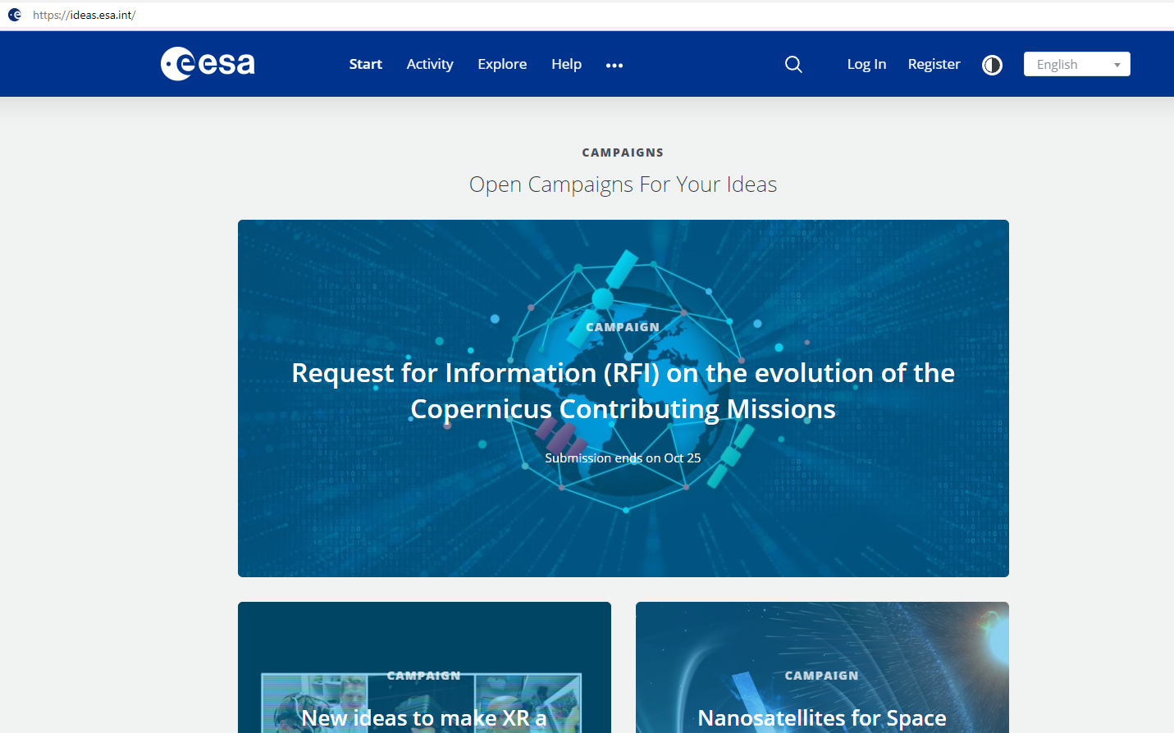
ESA Tools Basics of ESA procurement
Open Space Innovation Platform
The platform to submit your Idea for activity types H
Submit your Idea
Activity types H
https://ideas.esa.int

Slide 7
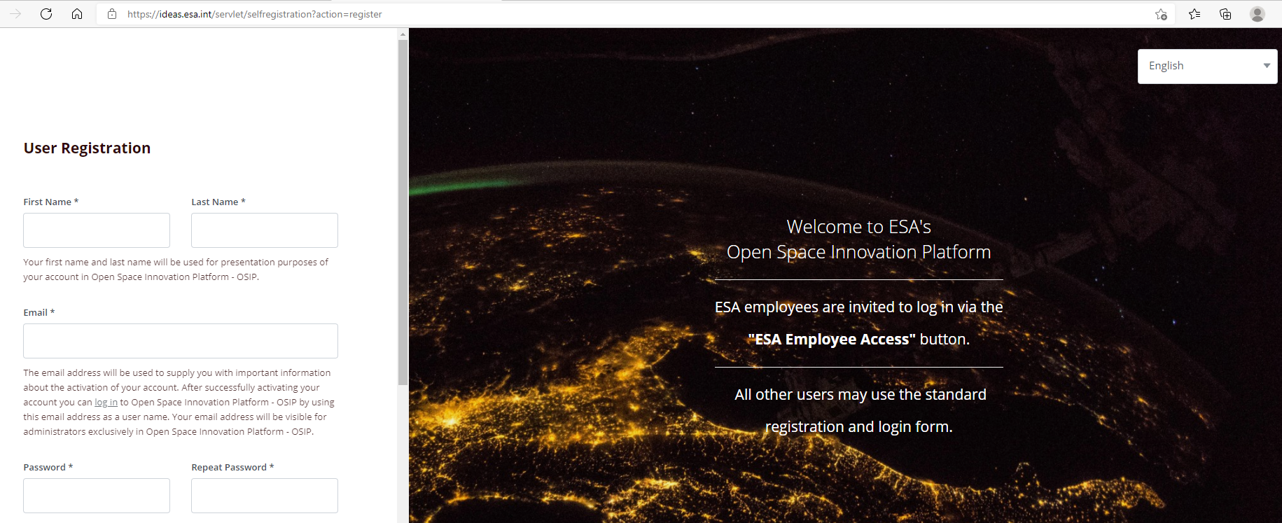
Open Space Innovation Platform - OSIP
Step 1: Register in OSIP (https://ideas.esa.int)

Slide 8
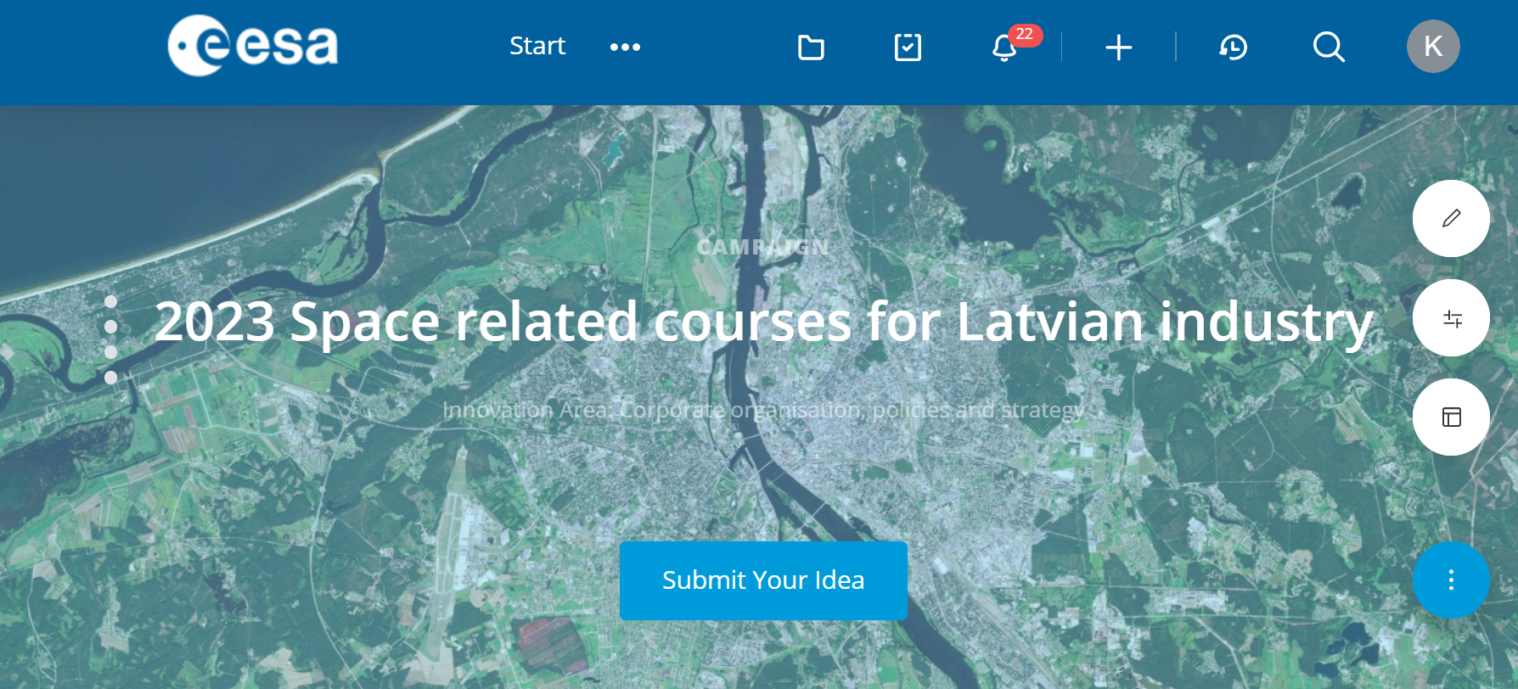
Open Space Innovation Platform - OSIP
Step 2: Look for the campaign of your interest (Open Space Innovation Platform - OSIP - Campaign: ‪2023 Space related courses for Latvian industry‬ (esa.int))
Activity type H in OSIP

Slide 9
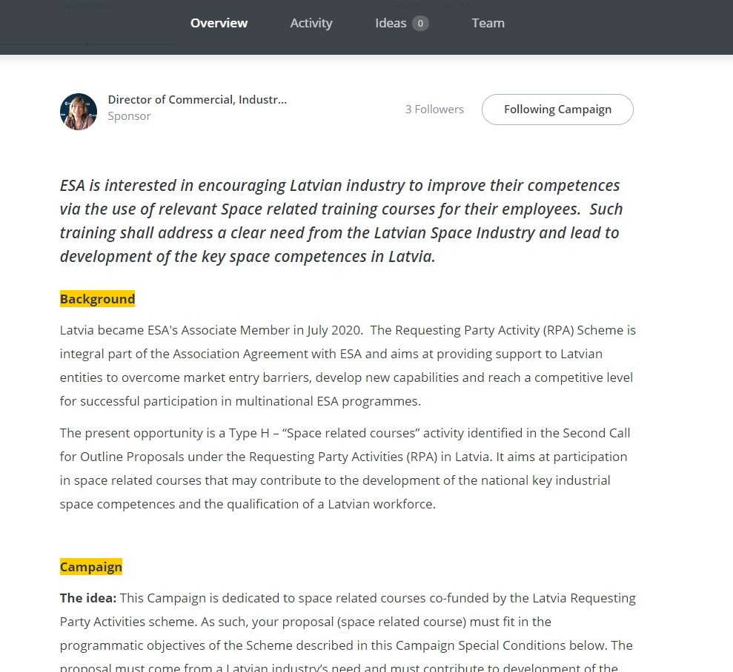
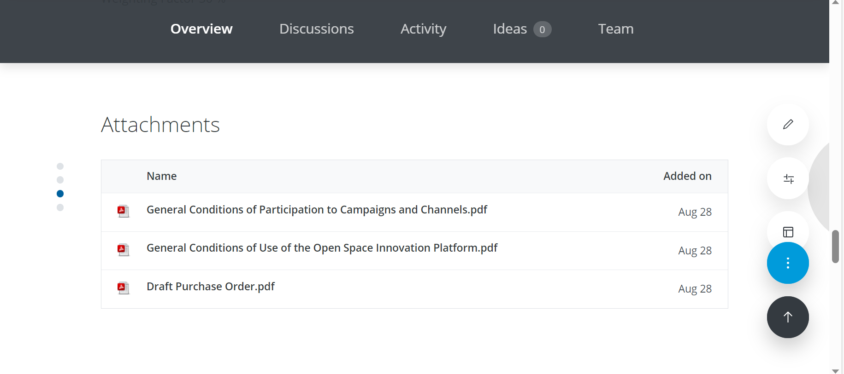
Open Space Innovation Platform - OSIP
Step 3: Read in detail Campaign Special Conditions, Process, Evaluation Criteria, Ideas Selection and applicable documents

Slide 10
H – Space related courses
OSIP Campaign
Space related courses for Latvian Industry
The Idea
The subject of this campaign is exclusively for Space related Courses that correspond to a clear need from the Latvian industry and would lead to develop the key space competences in Latvia.
The proposal must come from a Latvian industry’s need and must contribute to development of the specific space related competences needed to increase the capabilities of the Tenderer in the space business.
The Idea should be aligned with the generic programmatic objectives of the Latvia RPA ITT.
This Campaign is addressed only to Latvian companies (including SMEs). Potential Tenderers are therefore requested to note that the Agency can only consider Proposals from companies residing in Latvia.
Prime Contractorship
This campaign is exclusively for industry.
Price
The total amount awarded to any one company cannot be higher than 10.000 euro and it will be paid based on reimbursement of actual incurred costs. The reimbursement of the cost is limited to:
Course enrolment
Travel and accommodation
Daily allowance
The salaries of the persons being trained shall NOT be covered by the Agency and shall be instead covered by the company as co-funding of the training.
Duration of the activity
The training must be completed within 12 months from the date of the proposal submission.
A maximum of 5 Ideas will be co-funded for this Campaign. A maximum of 10.000 Euro can be awarded to one company.
Notes:
MOST IMPORTANT. What are we looking for? Cannot be just what they wish, it should be space related (to the needs of the company/capabilities). It must be related to well-established daily business (so NOT a new idea). Should cover the gaps/missing competences of the company.
Not included (salary, insurance), personeel involved must be company employment during the whole duration. Company pays salary/insurance as usual.

Slide 11
H – Space related courses
OSIP Campaign
Space related courses for Latvian Industry
Evaluation Criteria
Criterion 1 - Relevance with the company long term space plans (prospects of usage) and potential impact on the company’s space business
What will be the long-term impact of the training for the company
Clear identification of the business need(s), skills required and their relationship with the training programmatic objective(s)
The space specificity of the course
Value for money
Suitability of the trainee CV
Weighting Factor 70 %
Criterion 2 – Compliance with the Purchase Order Conditions
The proposed course/ training shall result in a satisfactory completion certificate.
The proposal has to include a detailed, fair and reasonable cost break down
The total price is within the indicated budget and compliant with the price type (Limit of Liability)
The training shall be completed within 12 months from the date of submission of the proposal
Weighting Factor 30 %
Notes:
How much in line with their business, how strongly justified to follow this course.
When submit, should explain the scope of the course (this will be assessed). MUST be space related (no ground station), i.e. skills must. E.g. space telecommunication, then ground station is fine. -> this included in justification
C2: important that they should finish with some certification/diploma/proof they followed the course

Slide 12

Type H - how to submit your proposal
Step 4: Submit your Idea directly in OSIP

Slide 13
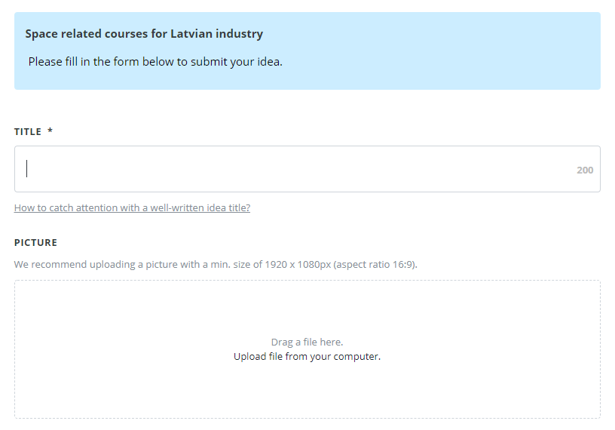
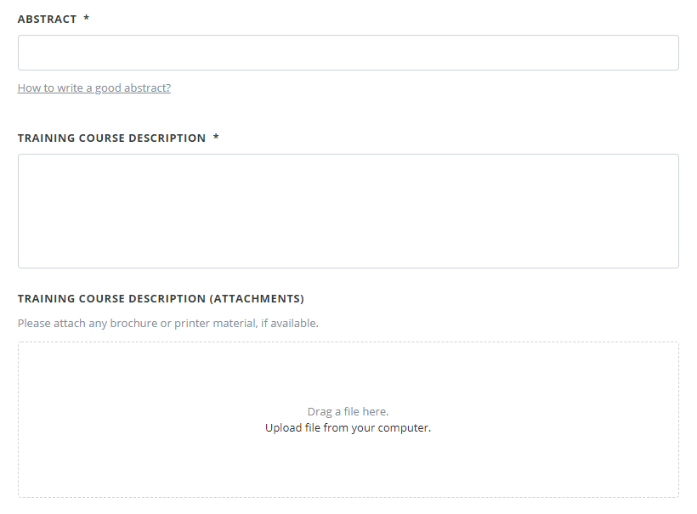
Type H – how to submit your proposal
We want to know what the training course is AND exactly what it will cover (full contents). Feel free to add documents to help.
Ignore the picture – not needed
Notes:
Important: submission does not mean submitting documents, you are fulfilling information online (via browser). This is not a proposal submission. All fields described in browser and to be filled in there as well.
If wished, files can be uploaded (for example ToC of course/course content)

Slide 14
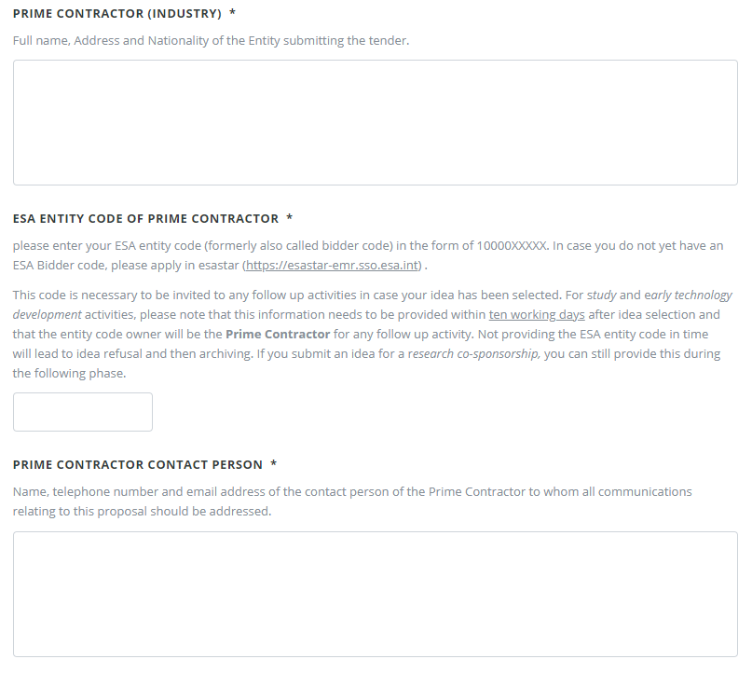
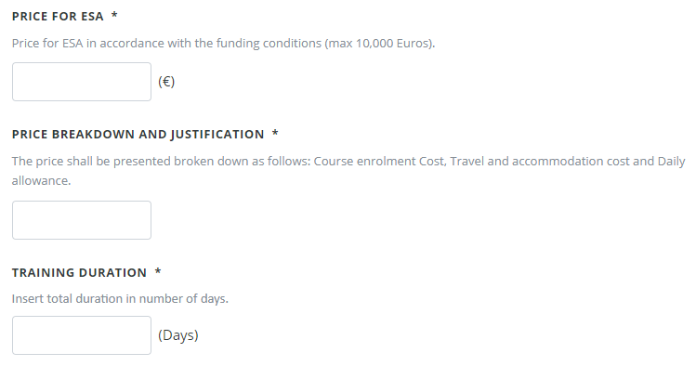
Type H – how to submit your proposal
For the price breakdown we want an estimate of:
Training course enrollment cost
Travel costs to and from the training
Hotel and subsistence costs
Give as much detail and justification as you can. If it is an estimate – state it. The cost of the course should be a quote.
Is this for 1 person or multiple, how many?, be clear
Note – we do not pay salaries/ hourly rates
Note2 – we will do the final reimbursement against actual expenditure.

Slide 15
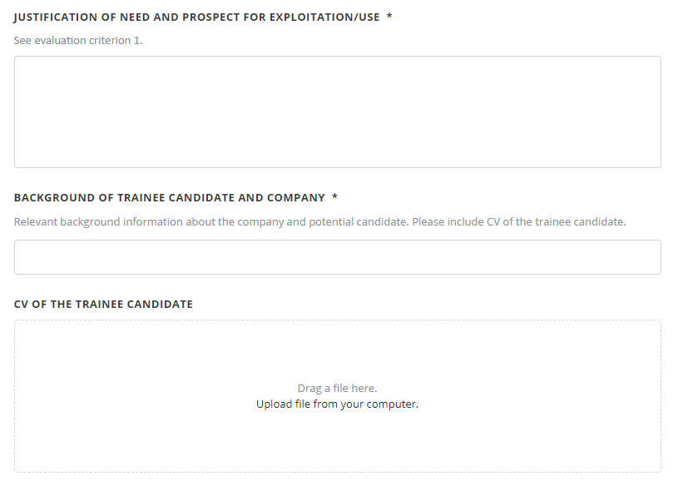
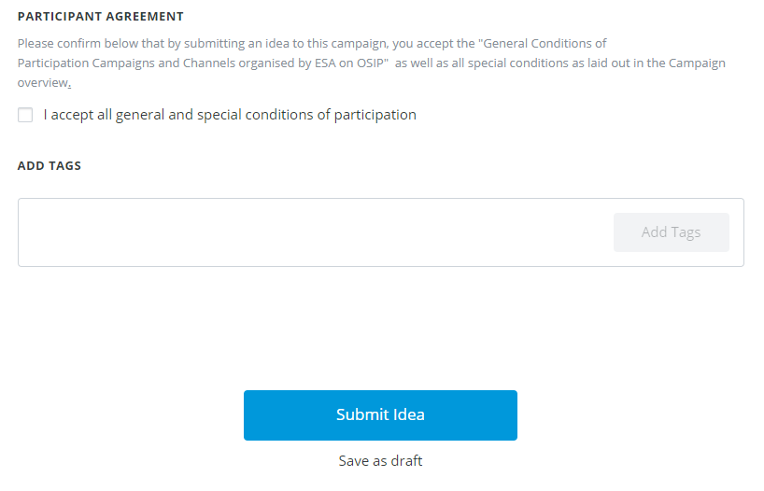
Type H – how to submit your proposal
The most important part. Why is this course needed and how will it help the company in the medium to long term?
We are mostly interested in the current role of the person in the company and how this course fits with that/ will help that.
Notes:
Justification most important! Background as well if it is a match. Not standard format of CV.
Private tutoring – industry to industry also possible. Instead of paying the fee, we pay TAS for preparation (Company pays to TAS after receiving from ESA)

Slide 16
Process after submission
A quick overview of
H activities process
Notes:
Everything the same except for PO instead of conract

Slide 17
Process after submission
Type H
If a proposal is recommended, a Purchase Order, a simplified form of contract will be signed by the Prime Contractor and ESA.
The draft Purchase Order will be attached to the OSIP campaign, for your information only.

Slide 18
Schedule
What | When
Publication in esa-star Publication | 19 September 2023
Deadline for submission of Ideas | 31 October 2023, 13:00 hours (Amsterdam time zone)
Tender Evaluation Board (TEB) meeting | End January 2024
Programmatic review | February 2024
First communication to Bidders | 4-6 weeks after the programmatic review (positive outcomes will be conditional to approval by the ESA IPC)
First Purchase Orders | Q2 2024

Slide 19

Questions?
For questions related to specific projects or issues use the one-on-one sessions. In the one-on-one sessions please do not ask general questions – they are very limited in time.
For issues DIRECTLY related to this Call, contact the Contract Officer:
Email: Marco.Peru@ext.esa.int Phone: +31 71 565 5374
For issues NOT related to this Call, feel free to contact:
Email: Karol.Brzostowski@ext.esa.int Phone: +31 6 4845 6263

