Slide 1
Estonia and PISA
Eda Tagamets
Analyst
Ministry of Education and Research of Estonia

Slide 2
Estonia in International Large-Scale Assessments
TIMSS – 2003
PISA – since 2006
IELS – 2018
TALIS – since 2008
PIAAC – 2008-15, 2018-24

Slide 3
Estonia in PISA, participation
Year | Schools | Students
2006 | 169 | 4865
2009 | 175 | 4727
2012 | 206 | 4779
2015 | 207 | ≈6000
2018 | 232 | ≈7000
2022 | 198 | ≈7500

Slide 4
Estonia in PISA, results
Year | Reading | Mathematics | Science
2006 | 501 | 515 | 531
2009 | 501 / 493 | 512 / 496 | 528 / 501
2012 | 516 / 496 | 521 / 494 | 541 / 501
2015 | 519 / 493 | 520 / 490 | 534 / 493
2018 | 523 / 487 | 523 / 489 | 530 / 489
2022 | ? | ? | ?

Slide 5
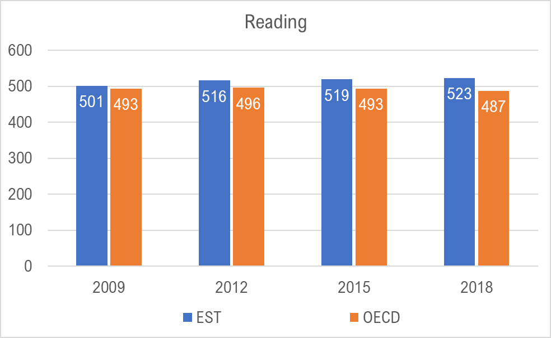

Slide 6
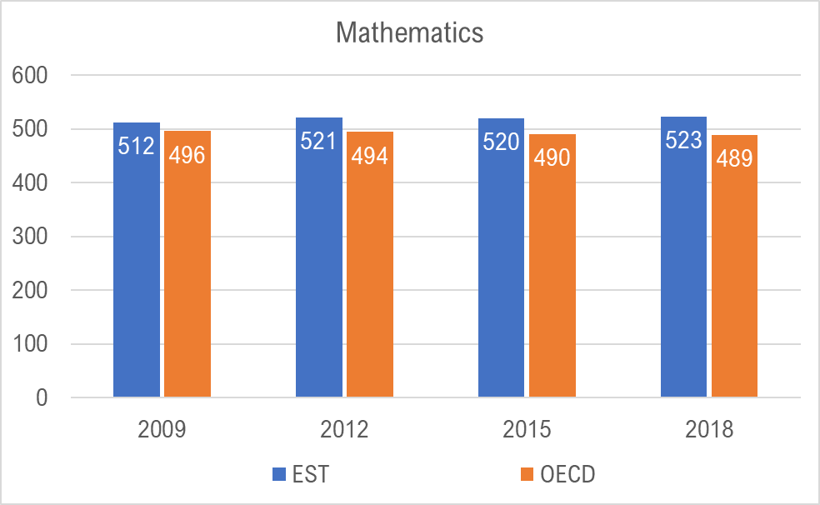

Slide 7
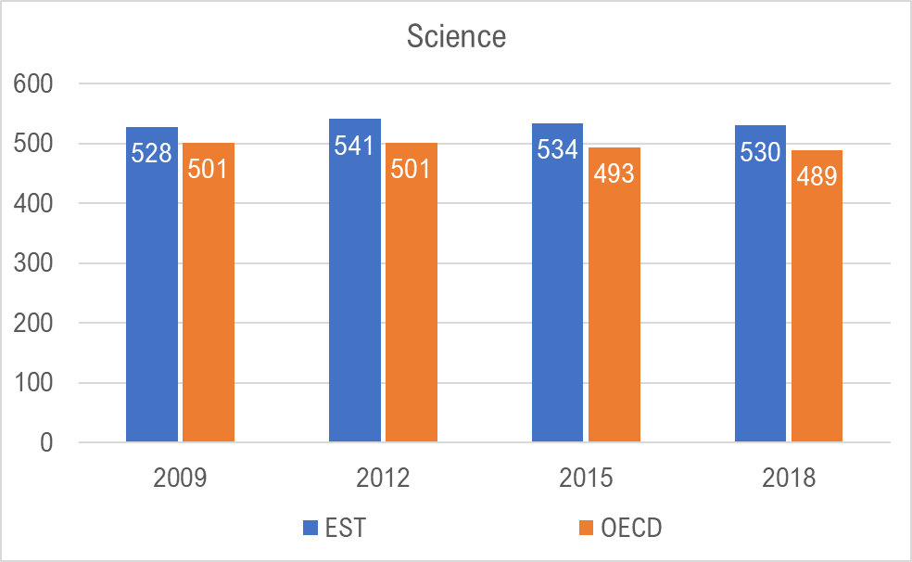

Slide 8
Indicators in national educational policy planning
Indicator | 2015 | 2018 | 2022 (goal) | 2025 (goal) | 2035 (goal)
% of 5th-6th level students, reading | 11,1 | 13,9 | 15,4 | 16,3 | 20
% of 5th-6thlevel students, math | 14,2 | 15,5 | 17 | 18,6 | 25
% of 5th-6thlevel students, science | 13,5 | 12,2 | 13,7 | 14,9 | 20
% of below 3rd level students, reading |  | 32 | 31,5 | 31 | 27
% of below 3rd level students, math |  | 31 | 30,5 | 30 | 26
% of below 3rd level students, science |  | 30,2 | 29,5 | 29 | 25

Slide 9
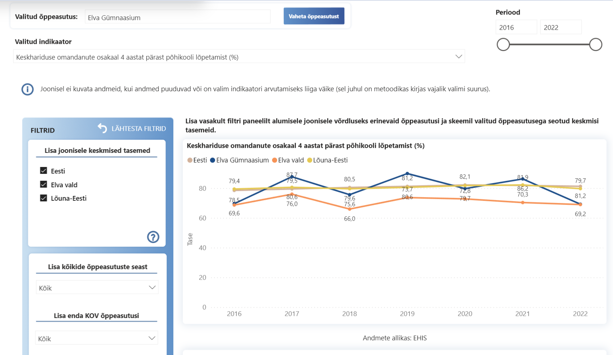
Data Backed Decision Making
haridussilm.ee

Slide 10
Public Response Scenarios
Scandal
Glory
Indifference
Steiner-Khamsi, G.& Waldow, F. (2018): PISA for scandalisation, PISA for projection: the use of international large-scale assessments in education policy making – an introduction. Globalisation, Societies and Education. doi.org/10.1080/14767724.2018.1531234

Slide 11
Public Response (Estonia)
Reserved Appreciation („Estonia jumps to third place globally in 2015 PISA rankings“)
Skepticism („Head Teacher: We Definitely Have Room for Development“)

Slide 12
Explanations?
Education highly valued
Small non-hierarchical, homogenous society, high equity
Accessible and good early childhood education
Innovative curriculum
Teacher professional qualification requirements
Autonomy of schools and teachers

Slide 13



Are We Actually Doing Well?

Slide 14
Are We Actually Doing Well?
Equity and inclusion
Stakeholder engagement and professionalisation
Evidence-based decision-making
Student, teacher and school autonomy and accountability
Being improvement and quality oriented
Alignment
High status of education and teachers
Transparency in plans

Slide 15
Are We Actually Doing Well?
Still too much and too early selection and tracking (incl language)?
Education doesn’t transform into adult skills, income and economic development?

Slide 16
What is Latvia Doing Better?
Smaller differences between schools across language (SES)

Slide 17
Estonia vs Latvia
In Estonia, intensive interventions spanned a shorter period, focusing on particular teaching approaches and curriculum elements, and educational officials spent more time and effort to get school principals and vice-principals on their side.
In Latvia […] there seemed to be more initial resistance there. School teachers and principals did not feel like active participants in the ongoing reforms even when they agreed with the new approaches.
Khavenson, T. (2018). Postsocialist Transformations, Everyday School Life, and Country Performance in PISA: Analysis of Curriculum Education Reform in Latvia and Estonia.

Slide 18
Estonia vs Latvia: Insider View
equity
school and teacher autonomy
school network optimization → competition
versatile curricula
inner strive for improvement
balance between tradition and innovation
Tire, G. (2021). Estonia: A Positive PISA Experience. In: Crato, N. (eds) Improving a Country’s Education. Springer, Cham.

