Slide 1

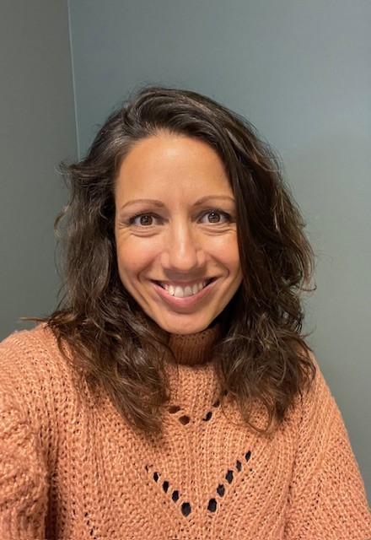

Personal Growth – Collective Success
A Whole-School Approach to Wellbeing
Linda Blomdahl
National inspector of Sweden
Author and Coach
Notes:
Thank you to the Latvian Presidency for inviting me today. I am so happy to be here at my first Teachers’ forum. I know I don’t know all of you but maybe I have seen some of you and maybe some of you have actually seen me.
As you can see my name is Linda Blomdahl and I’m the Swedish inspector. Before I became an inspector I was a director for almost ten years and before that I was a teacher for about fifteen years. In 2020 I wrote and published my first book about wellbeing in schools. It’s subtitle is actually the same as the title of my little speech her today: Personal Growth- Collective Success.
Most of you are probably very interested in the area of Wellbeing. Still, I hope I can give some new light about how our own personal growth can lead to a postive school climate.

Slide 2
What if we could…
Rule our minds
Notes:
So I will start with a provocative statement. What if we could rule our minds. What if we could decide what to think, how to feel and how to behave? What if everything that we can see in this room actually started with a thought? Someones idea about creating this building. Like going to the moon, what if it all started with someones thought about actually going there?
I think you see where I am going…

Slide 3
Feeling
Thought
Behaviour
Notes:
Lets make an exercise.
I want you to think about someone that makes you really happy. It could be your dog, sister, child, colleague, former teacher, friend. Can you feel it in your body? What happens? Maybe the thought makes you smile, loosen up, maybe even laugh a little bit.
Now I want you to think about something or someone who makes you feel angry, sad, judged, badly treated, annoyed. What happens now? No smiles? Maybe you are feeling tense, maybe you want to tell someone about how this person treated you?

Slide 4
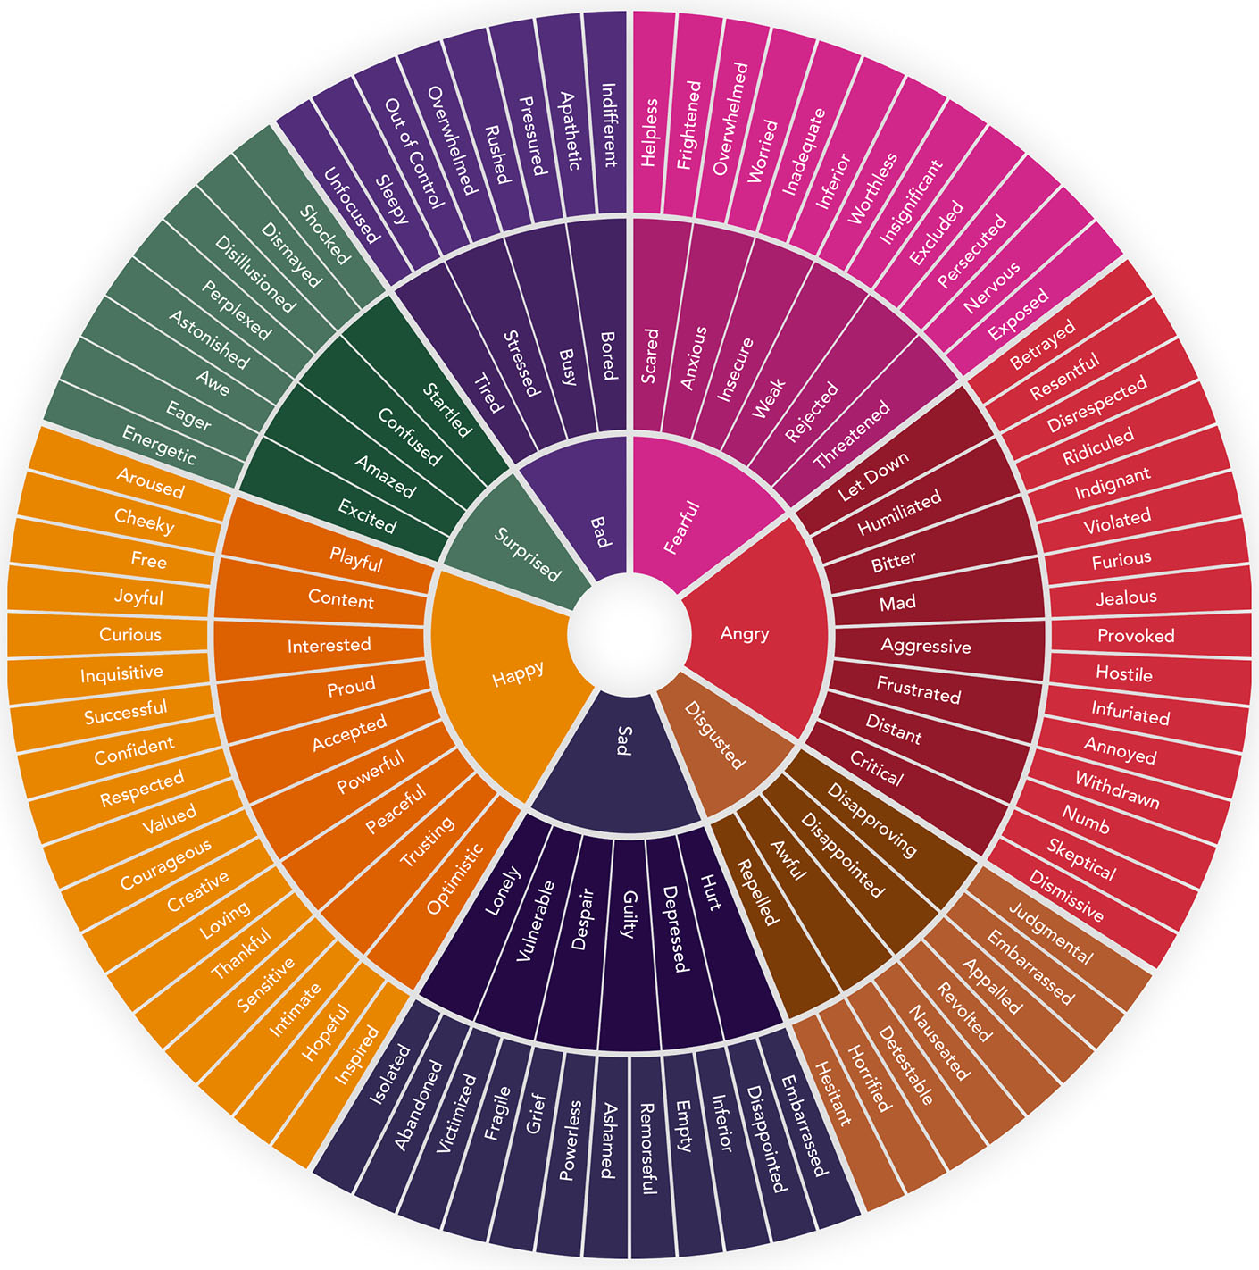
Notes:
And that’s the thing with this process. Not all of our thoughts are good ideas or nice, friendly thoughts. Most of the time we are not even aware of what we are thinking. We are overwhelmed by our own feelings. And the feelings have impact on our thoughts and it feels like they are determining our actions, our behaviour. You might think, yes maybe for a child but I am an adult and I can handle my own feelings and decide how I want to behave. Well, we all know that’s not completely true.
This is the wheel of emotions. You’re not supposed to be able to read all these feelings but maybe you can see that there are more ”negative” feelings than positive. This has helped us survive by teaching us what’s good and bad for us.
Let’s think about the triangle with thought, feeling and behaviour again.
If a teacher surprises her pupils during a lesson, if she makes them curious or make them laugh they will focus better and their chances of learning will increase.
If a teacher yells at one of their students for being late to the lesson and maybe does it in front of all of the student’s friends, this student probably will feel angry and humiliated. He might even be furious about this, he might scream back and leave the lesson.
If we can’t control our feelings or thoughts they will control us.
Some people say that school can’t be about feelings, it’s about knowledge, teaching and learning. Pupils should behave well and if they don’t the misbehave and should be punished.

Slide 5

The mission of the Swedish school
The mission of the school is to promote learning by stimulating each individual to acquire and develop knowledge and values. In partnership with the home, schools shall promote the all-round personal development of pupils into active, creative, competent and responsible individuals and citizens.
Notes:
This is the mission of the Swedish school.

Slide 6

The mission of the European School
The mission of the European school
Rooted in European and democratic values, the system fosters citizenship, intercultural understanding and cooperation, equipping pupils with the competencies necessary to thrive academically, socially and personally in a diverse and a rapidly changing globalised world.

Slide 7
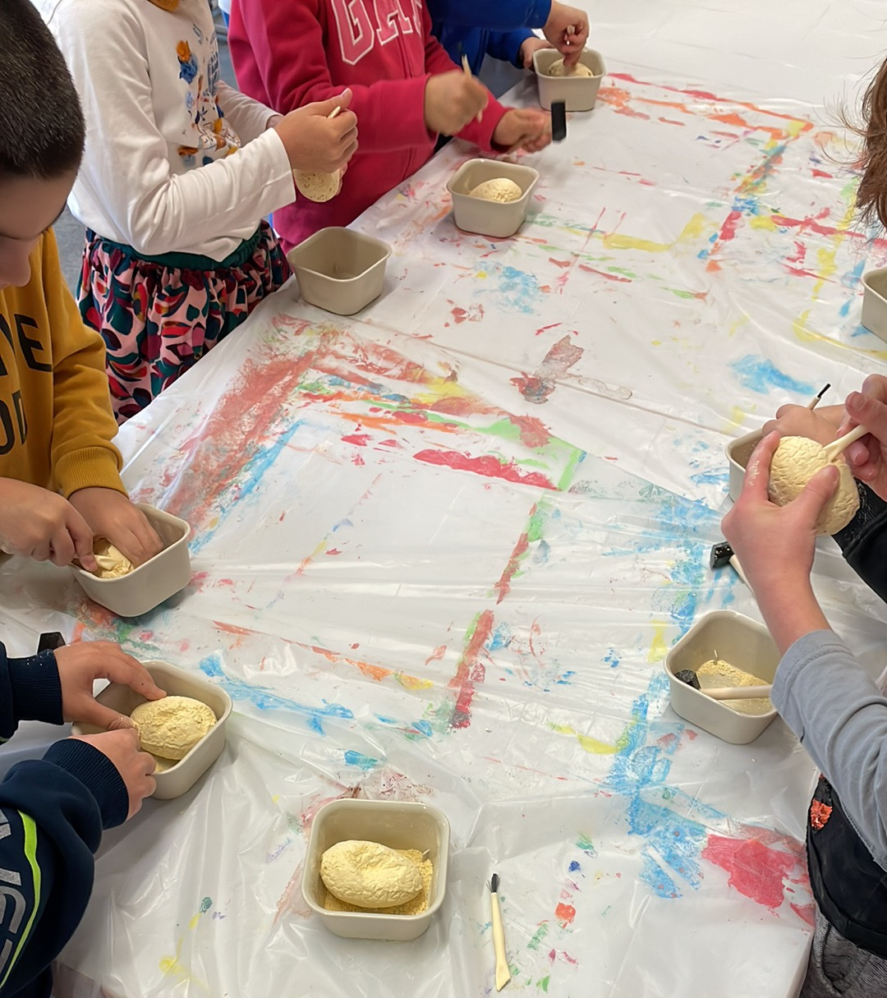
What unites us?
Good individuals and citizens
Good knowledge and values
Necessary competencies for managing in the world
Cooperation/partnership
Notes:
The school is about teaching and learning but not only about achieving good grades. It´s also about feeling well, being a good friend, understanding and practising everyday democracy and most of all, it’s a cooperation or partnership with the parents of the children.

Slide 8
A positive school climate
Teaching staff
Non-teaching staff
Students
Parents
Experts
Media
Notes:
Look at these two shapes and the different categories. What happens when teachers and other staff at school feel stressed and overwhelmed and how would it change if they instead were mentally fit and resilient?
What change would it make if the students were engaged in learning and motivated instead of stressed and disengaged?
What change would it make if the parents were mentally fit and not overwhelmed, over-protective or negligent?
What happens when the experts we use are non-evidence based fashion followers instead of us using evidence based experts who are valuing knowledge and experience?
And we all know how much social media affects us.

Slide 9
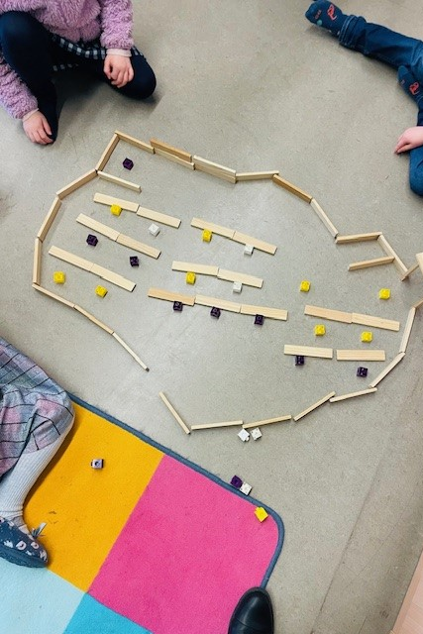
Once we become aware of something, we have the choice to change it.
Notes:
Let’s face it: We only know what we know. There are so many things that we are not aware of about ourselves. We need to give ourselves time to reflect about our thoughts, feelings and our own behaviours. And we need to help our pupils to talk about their thoughts and feelings, not only their behaviour. We need to understand why we do what we do. Then we can understand why other people do what they do and that can help us see the potential behind the behaviour. All this will help us understand how we can have a whole-school approach to wellbeing and create a positive school climate.
Commitment is what happens when you truly accept, choose or take responsibility for your thoughts, feelings or actions. This leads to a higher performance.
BUT!
When you are ordered to be responsible and don’t accept it, your performance will probably be lower.

Slide 10

Positive school climate
Change never starts with the whole school.
It starts with the individual.
Notes:
A positive school climate doesn’t mean that we have to be happy and positive all the time. It means that we want to be committed and interested in taking responsibility for our thoughts, feelíngs and actions.

Slide 11
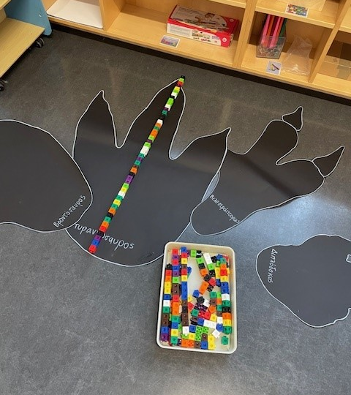
Mindset matters
DESIRE
DEFINE
DISCOVER
DREAM
DESIGN
DELIVER
Contextual wellbeing model: Dr Helen Street
Notes:
Wellbeing is a state of health, hapiness and positive engagement in learning.
There are many models describing how to navigate towards a goal.
Desire: We want to increase the wellbeing in our schools.
Define it: what are the areas which we want to work on?
Discover: What is already working well in our schools?
Dream: Allow yourselves to dream about it. What would it be like if all our wishes came true? What is our vision?
Design: Let’s make the plans for this positive change.
Deliver: Decide what steps to take, the needs, the support, the actions.

Slide 12
Feelings
Thoughts
Behaviour
Notes:
Let’s end wtih a practical example. We are going to start with a behaviour which will hopefully give you a feeling and leave you with a thought. And I want you to pay attention to the feeling and I want you to remember it afterwards and I want you to think about what happens if you start by changing your behaviour instead of trying to change your thoughts or feelings.
I want you to look at the person next to you. Make sure you all have someone to look at. Then I want you look him or her in the eyes, to smile. I want you to smile in a way that reaches your eyes, I want you to give your neighbour an honest smile and I want you to feel the smile even in your toes. And I want you to try to keep this feeling during the break.

Slide 13

Thank you for listening!
linda.blomdahl@inspector.eursc.eu

