Slide 1



A Whole-School Approach to Promoting Well-being for Success
Prof. Baiba Martinsone, Dr.psych.
University of Latvia

Slide 2
Education and mental health
Problems manifesting in the educational system (e.g., learning disabilities, developmental disorders, mental health problems)
Problems caused and sustained by the educational system/context (e.g., focus on academic achievement, school climate, chronic stress)
Looking for solutions. Intervention vs. prevention

Slide 3



Whole-school approach to well-being
European Council recommendation on Pathways to School Success (2022)
Better educational outcomes for all learners:
Reducing low achievement in basic skills​
Increasing attainment in secondary education ​
Promoting well-being in schools
European Commission’s Expert Group on promoting well-being at schools (2023-2024)
develop guidelines for a systemic, whole-school approach for well-being (at both the policy level and school level)
propose a self-assessment and self-improvement toolkit on well-being at school
Image Placeholder

Slide 4


Supporting well-being at school: new guidelines
https://education.ec.europa.eu/news/supporting-wellbeing-at-school-new-guidelines-for-policymakers-and-educators

Slide 5
Recommendations
1.Establish a positive school climate through the active participation and empowerment of learners
2.Integrate social and emotional education into the curriculum from early childhood education to upper-secondary education
3.Foster collaborative partnerships: strengthen school capacity for well-being through active engagement with stakeholders
4.Fully integrate well-being into Initial Teacher Education (ITE)
5.Strengthen school leaders’ capacity to address well-being at school
6.Create safe schools to prevent and combat various forms of violence at school, including gender-based violence, and (cyber)bullying
7.Promote well-being in the digital age
8.Safeguard core enablers of well-being: nutrition, play and rest, physical activity, and arts
9.Provide continuous professional development (CPD) and support to educators on well-being
10.Prioritise equity, inclusion and diversity as essential conditions for well-being
11.Guarantee access to support services for learners with mental health needs

Slide 6
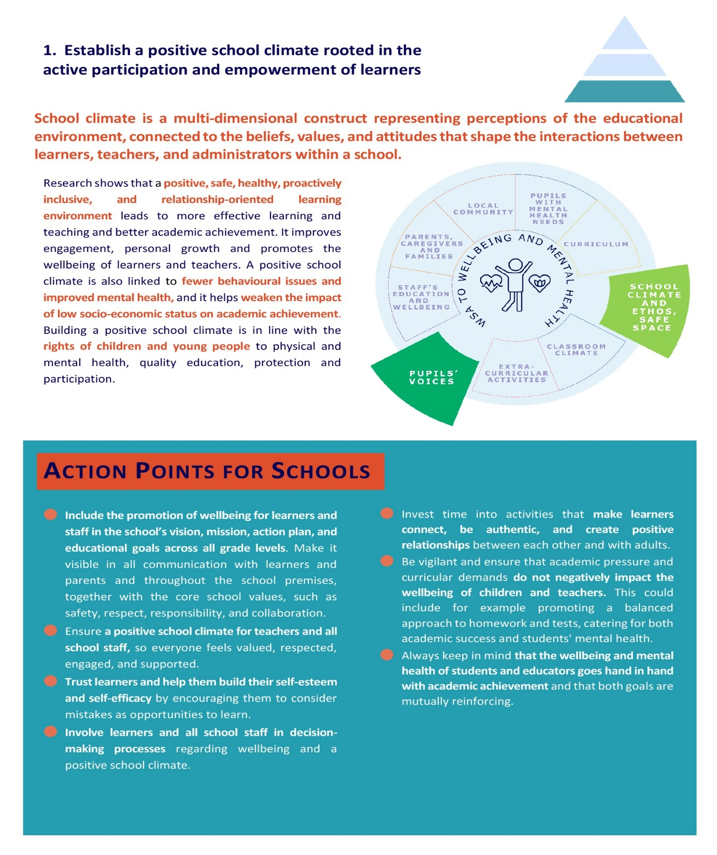
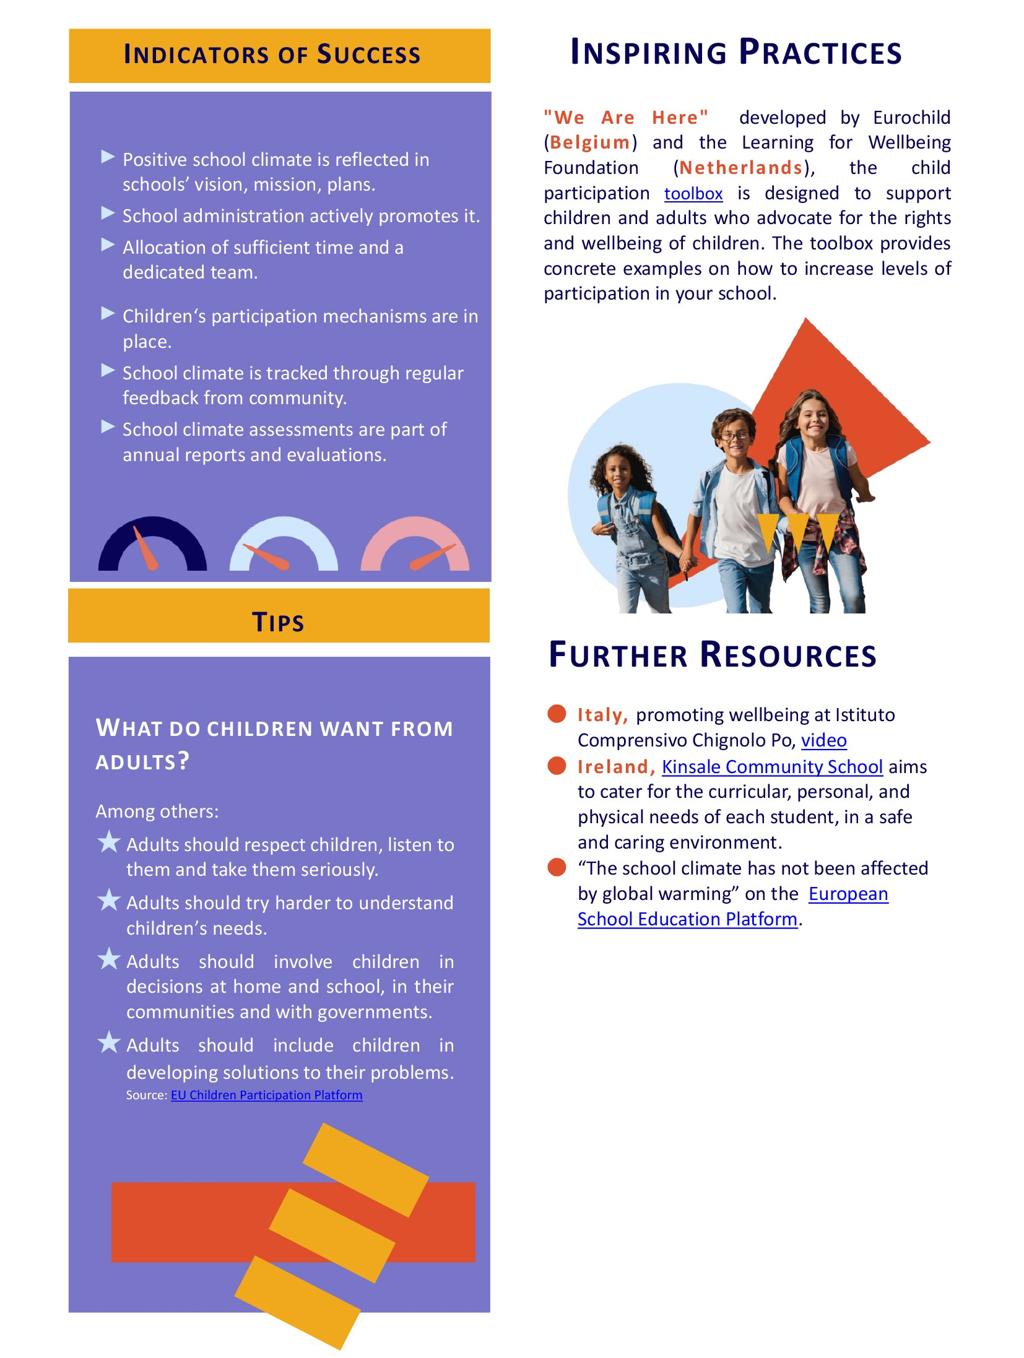

Slide 7
In preschool, better social-emotional skills are related to higher learning motivation and
lower level of behavioral problems
(Martinsone et al., 2023)
More positive perception of school climate is
related to better mental health outcomes
in adolescent sample
(La Salle et al., 2021)
After implementing a well-being program, significant increase in teachers’ self-efficacy and resilience
(Martinsone et al., 2023)

Slide 8
Our priority – creating a positive school climate through a whole-school approach to social emotional learning, and changes in teaching and assessing
Awareness of non-academic aspects of learning
Development of programs and materials to promote social emotional learning, mental health and well-being
Evaluate the effectiveness of interventions to provide policymakers with evidence to shape educational policy

Slide 9
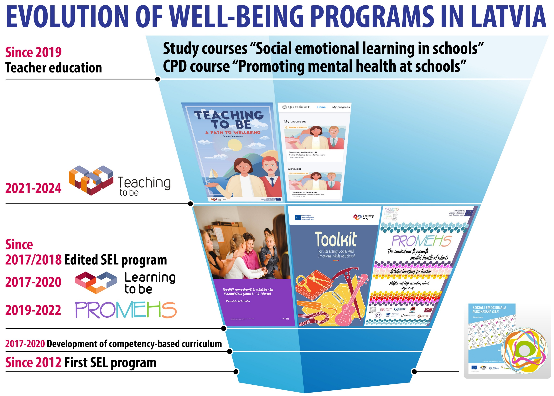
Notes:
Skolas resurss
Piederība
Skolā sistēma, ko darīt

Slide 10
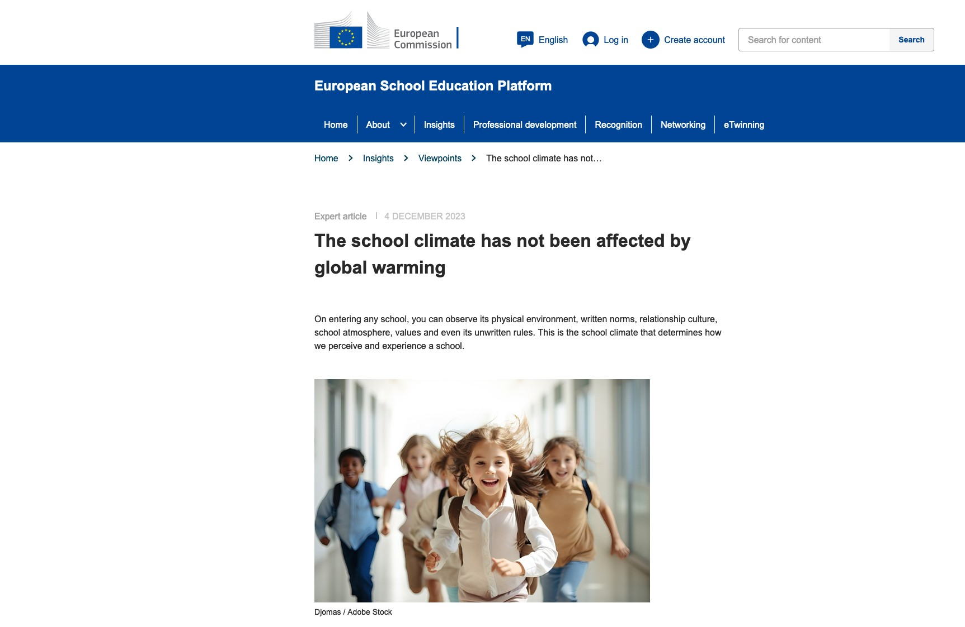

Slide 11

Thank you!
baiba.martinsone@lu.lv

