Slide 1

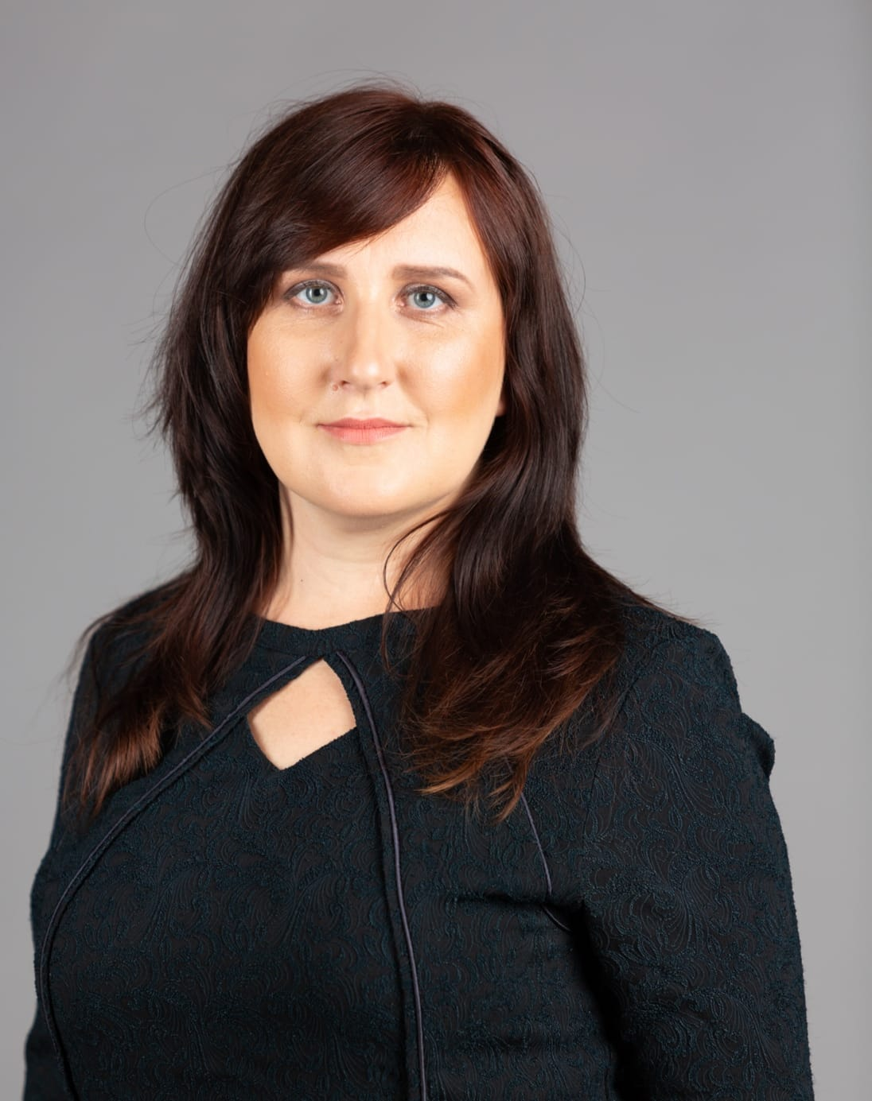

European Values in School Culture: from Belonging and Inclusion to Community Engagement
Photo of the Speaker
Inese Vaivare, Director of Latvian Platform for Development Cooperation (LAPAS)

Slide 2




Can we plan the future we cannot predict?
Education:
Are visionary schools possible in era of uncertainty?
from foresight to uncertainty
How to be “change-ready”?
What remains when everything changes?

Slide 3
Human Rights
Tolerance
Human dignity
Pluralism
Equality
EU values and social characteristics:
questioned?
Non-discrimination
Rule of Law
Justice
Freedom
Solidarity
Democracy
Equality

Slide 4



Wellbeing
01
02
03
04
05
Resilience
Conncetion
Belonging
Engagement
Subtitle
Supporting Text

Slide 5



Resilience
Democratic resilience
Collective resilience

Slide 6


Connection
Global
competence
Global
solidarity

Slide 7

Belonging
Safe
space
Brave
space

Slide 8

Engagement
Co-creation
Mobility

Slide 9
Intelligence is the ability to adapt to change.
Stephen Hawking

Slide 10


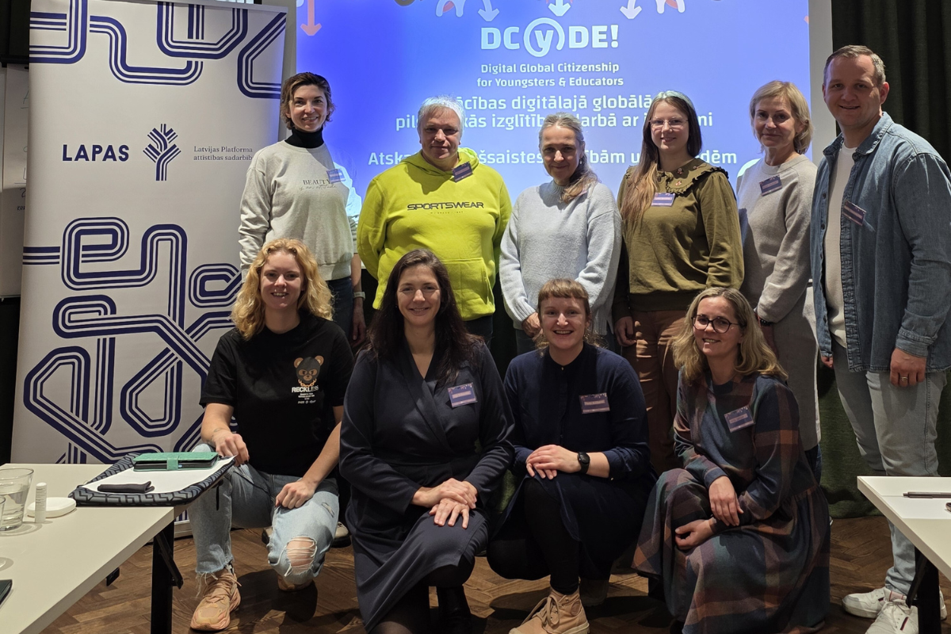
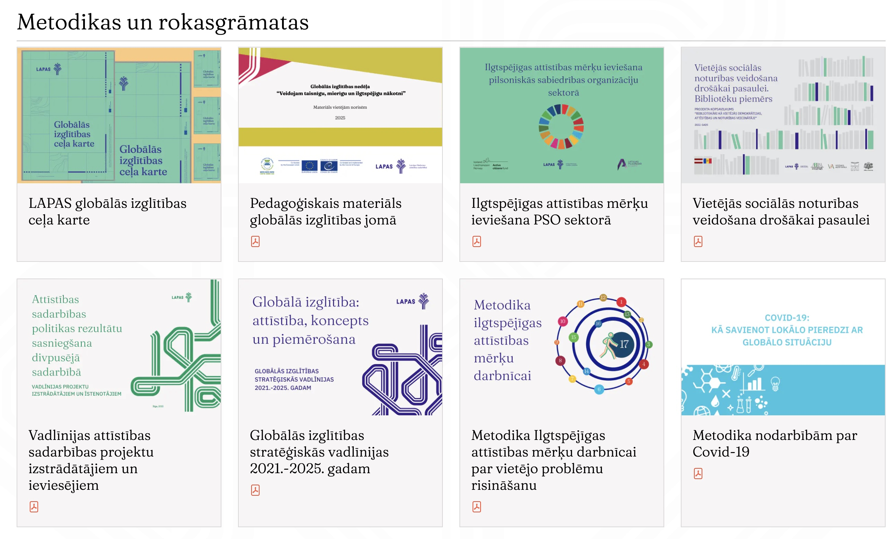
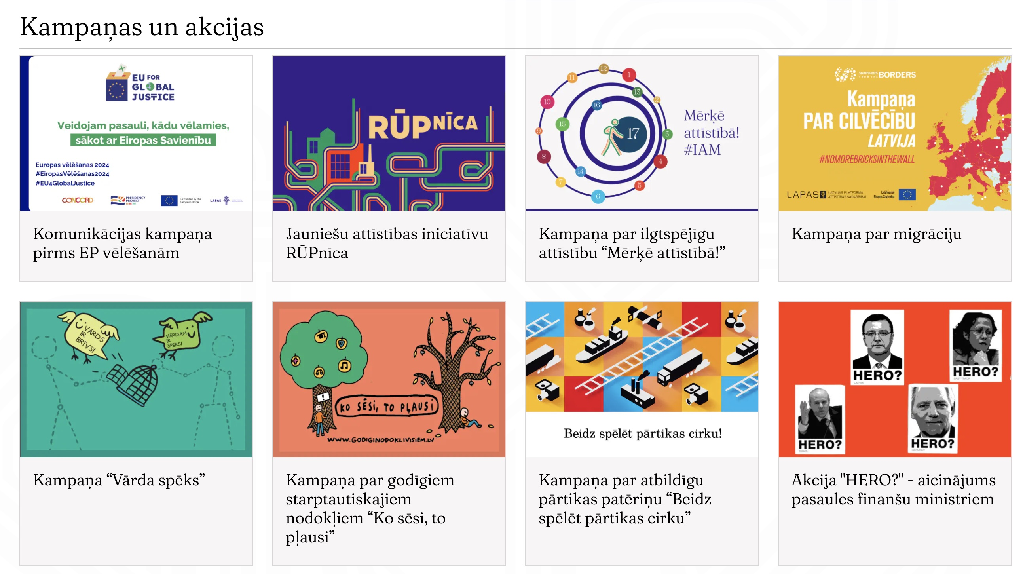
LAPAS resursi
Kopienas spēks:
*praktiķu tīkls;
*akcijas un kampaņas;
*domāšanas ietvars;
*kopīgi pasākumi.

Slide 11




Social Media
Website Link
@biedribaLAPAS
www.lapas.lv
@lapas_lv
Thank you!

