Slide 1
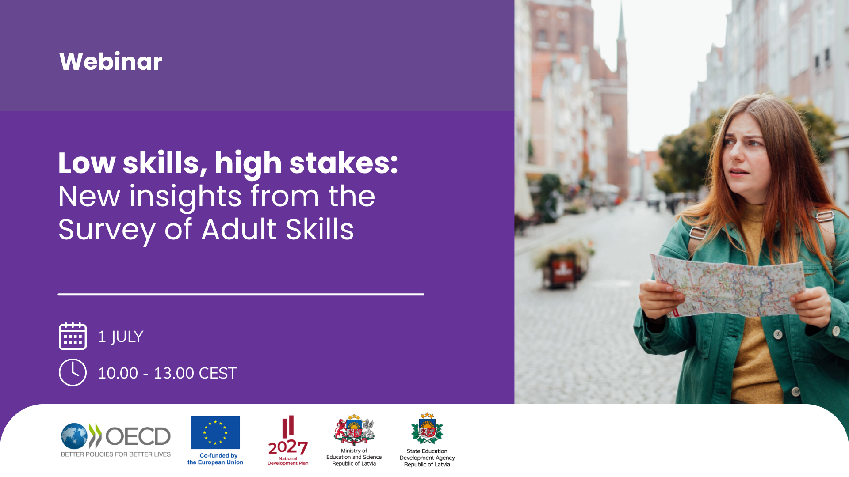

Andreas Schleicher
Director for Education and Skills, OECD
Andreas Schleicher – Director for Education and Skills

Slide 2
What is the 2023 Survey of Adult Skills (PIAAC)?
adults tested
representing
673 million
16–65-year-olds
in 31 countries
domains assessed
literacy, numeracy and adaptive problem solving
variables collected
e.g. education, employment, skill use
cycle in 2022/2023
enabling trend comparison with Cycle 1 (2012-2018)
160 000
3
800
2nd
Notes:
Thirty-one countries and economies participated in Round 1 of the 2023 Survey of Adult Skills. 160,000 adults were interviewed, representing over 673 million adults worldwide. [click]
The survey measures proficiency in literacy, numeracy, and problem solving - the foundational skills individuals need to participate in society and that economies need to prosper. [click]
It also collects rich background data to support four analytical goals: describing proficiency across subgroups; identifying factors that shape skill development; and examining links between skills and economic and social outcomes. [click]
This is Cycle 2. Cycle 1 ran across three rounds between 2012 and 2018, giving us a basis for trend comparison.

Slide 3

What are low foundational skills?
Literacy
Access, understand, evaluate and reflect on written texts
Low Literacy:
Achieve Level 1 or below
Numeracy
Access, use, reason critically with mathematical content, information and ideas
Low Numeracy:
Achieve Level 1 or below
Low Foundational Skills:
low literacy and / or numeracy
Notes:
Our new analysis focuses on adults with low foundational skills. [click]
We only look at literacy and numeracy – not adaptive problem solving - , because these are the two domains that allow for trend comparison across cycles.
Both are defined in ways appropriate for adults, not simply reading, writing, and arithmetic, but the ability to access, evaluate, and use written and mathematical information to function effectively in modern life.
[Click]
For this report, "low foundational skills" means performing at or below Level 1 in either literacy or numeracy on the PIAAC proficiency levels. Adults at this level typically struggle with tasks like locating a single piece of information in a short text, following simple instructions, or carrying out basic calculations. These are skills that underpin everyday workplace tasks and access to services.
[Click — present example item]

Slide 4
1
How many adults have low foundational skills and why does it matter?

Slide 5
One in three adults lacks essential skills
Percentage of adults scoring at or below Level 1 in literacy or numeracy, 2023
Notes:
On average, almost one in three adults across OECD countries - 31% - had low foundational skills in 2023.
[click]
But the variation across countries is striking.
In Finland, Japan, Norway, Sweden, and the Netherlands, fewer than one in five adults had low literacy or numeracy skills.
In Chile, this share is over 60%.
Many countries with comparable levels of development have very different shares of adults with low foundational skills.
This means that what we see here at least partly reflects policy choices. And that there is real potential to learn from the countries that are doing better than others.

Slide 6
These skills are the foundation of opportunity
Employment
Earnings
Well-being
Civic Life
3 in 10
adults with low foundational skills do not participate in the labour market
USD 5
lower hourly wages for adults with low vs. medium foundational skills
More than USD 10 in Singapore and Switzerland
Worse health outcomes,
lower life satisfaction
Lower trust in institutions, less likely to feel able to influence political processes (although not everywhere)
Notes:
The evidence is clear on the stakes. Adults with low foundational skills face significant disadvantages in employment, earnings, health, and civic engagement.
And when large numbers of adults lack these skills, productivity suffers, labour shortages are harder to address, inequalities deepen, and democratic participation weakens.
[Click]
The numbers are stark. 3 in 10 adults with low foundational skills do not participate in the labour market.
[Click]
Among those who are in work, hourly earnings are around five dollars lower on average than for adults with medium levels of skills - and in countries like Singapore and Switzerland, that gap exceeds ten dollars.
[Click]
Adults with low foundational skills also report worse health, lower life satisfaction, and weaker trust in others and in institutions.

Slide 7
Adults with low skills are far more likely to be inactive…
Adjusted percentage point difference in inactivity rates:
low versus medium foundational skills, 2023
Notes:
Across OECD countries, adults with low skills are much more likely to be inactive than those with medium skills.
Inactive adults are neither employed, nor looking for employment, typically due to discouragement, health issues, caregiving responsibilities, lack of skills that employer value or simply retirement.
On average, about 30% of adults with low skills are inactive, compared to 19% among the medium-skilled. [click]
This adjusted gap between adults with low and medium foundational skills is statistically significant in most countries and reflects a two-way relationship: low skills reduce participation in the labour market, and lack of participation limits skill development.

Slide 8
...but they are not more likely to be unemployed everywhere.
Adjusted percentage point difference in unemployment rates:
low versus medium foundational skills, 2023
Notes:
The gap in unemployment is less pronounced and consistent across countries.
On average, around 8% of adults with low foundational skills are unemployed, compared to 5% of those with medium skills. [click]
Adjusted differences are statistically significant in fewer than half of the countries, likely reflecting tight labour markets and historically low unemployment for all skill levels at the time of measurement.

Slide 9
The low-skill wage penalty exceeds USD 10/hour in some countries.
Adjusted difference in hourly wages (USD PPP):
low versus medium foundational skills, 2023
Notes:
There is a pronounced and consistent wage penalty associated with having low skills. On average, low-skilled adults earn about 20.5 US dollars per hour, compared to 25.5 for medium-skilled adults. [click]
This gap exists in all countries, although the size of the gap varies considerably.
In Switzerland and Singapore, it exceeds 10 dollar per hour.

Slide 10
Adults with low skills report worse health nearly everywhere…
Adjusted percentage point difference in reporting excellent or very good health:
low versus medium foundational skills, 2023
Notes:
Adults with low skills are less likely to report good health.
On average, 33% report very good or excellent health, compared to 47% of medium-skilled adults. [click]
Differences are significant in most countries, even after accounting for demographic factors, including age, gender and migration background.

Slide 11
…a pattern that holds for life satisfaction.
Adjusted percentage point difference in reporting high life satisfaction:
low versus medium foundational skills, 2023
Notes:
A similar pattern is observed for life satisfaction.
About 67% of low-skilled adults report high life satisfaction, compared to 77% among the medium-skilled. [click]
Largest adjusted gaps are observed in Italy, but Latvia also has one of the largest adjusted gaps in life satisfaction between low and medium-skilled adults.

Slide 12
Low foundational skills are associated with lower interpersonal trust…
Adjusted percentage point difference in reporting high interpersonal trust:
low versus medium foundational skills, 2023
Notes:
Adults with low foundational skills also report lower levels of interpersonal trust.
On average, 25% report high trust, compared to 35% among medium-skilled adults. [click]
This relationship is relatively consistent across countries and stronger than for some other civic outcomes.

Slide 13
…and lower participation in volunteering in most countries…
Adjusted percentage point difference in reporting participation in volunteering:
low versus medium foundational skills, 2023
Notes:
Participation in volunteering is also lower among adults with low skills.
Around 23% report volunteering, compared to 33% of medium-skilled adults. [click]
The largest gaps are observed in Germany, Norway and the United States. By contrast, there are no significant differences between groups in Finland and the Slovak Republic.

Slide 14
…but not always with lower political efficacy.
Adjusted percentage point difference in reporting high political efficacy:
low versus medium foundational skills, 2023
Notes:
In contrast, average differences in political efficacy are small. Political efficacy is the perceived influence over government. It is shaped by individual capability, but also by institutional design, political culture and perceived fairness. Around 16% of low-skilled adults report a high sense of political influence, compared to 18% among the medium-skilled. [click]
The relationship varies across countries and is not uniformly positive. In two countries – Israel and Poland – adults with low skills report higher political efficacy than those with medium skills.

Slide 15
Progress is stalling – in many cases reversing
Change in share of adults scoring at or below Level 1 in literacy or numeracy, Cycle 1 and Cycle 2
Notes:
What makes this even more troubling is the trend. Despite a decade of investment in adult education and training, the share of adults with low foundational skills has grown in many countries.
[click]
In 11 of the 27 countries that participated in both cycles, the share has increased significantly - the dark green bars on the right.
The largest increases were in Lithuania, Poland, Korea, and Hungary.
Many countries saw no significant change – the light green bars here.
Only Denmark and Finland recorded meaningful reductions.
[Click]
But we need to ask: is this a genuine deterioration in skills, or is it driven by demographic change: an ageing population, or a higher share of migrants?
[click]
The answer varies by country. Here you can see the adjusted trend taking account demographic change.
In Austria, accounting for demographics reduces the apparent increase from 10 to 6 percentage points.
In Norway and Sweden, it turns a flat trend into an underlying improvement.
But in Czechia, Hungary, and the Slovak Republic, demographic adjustment makes almost no difference. The deterioration there is real and broad-based.
So, while demographics explain part of the story in some countries, they do not explain it away everywhere.
[Note: Latvia is not in graph, as they did not participate in Cycle 1]

Slide 16
2
Who has low foundational skills?

Slide 17
Adult with low foundational skills are not a homogenous group
Share of adults with low foundational skills by reader profile, by country, 2023
Notes:
We tend to talk about adults with low foundational skills as a homogenous group. But there is considerable internal diversity. For example, our analysis reveals four distinct reader profiles.
[click]
Fluent readers are fast and accurate. Their share ranges from around 12% in Singapore to over 40% in Croatia and Czechia. Countries with larger fluent reader shares tend to be those where the low-skilled population clusters closer to the threshold to medium proficiency
[click]
Effortful readers are accurate but slow. They are most prevalent in Austria, Lithuania and Portugal, where they account for a third or more of the low-skilled population.
[click]
Surface readers are fast but not accurate. They are most prevalent in Israel, New Zealand, Poland and the United States. This profile may reflect limited engagement with the assessment or a response style that favours speed.
[click]
Struggling readers are both slow and inaccurate. They account for at least 45% of the low-skilled population in Norway, Singapore and Sweden. This is in part driven in part by the high share of adults assessed in their non-native language.
Migrants represent 38% of struggling readers on average across OECD countries, rising to over 80% in Norway and Sweden.
Importantly, these profiles have real consequences: among native-born adults, inactivity is ten percentage points higher among struggling readers than among fluent readers.

Slide 18
Low education is the strongest predictor of low skills
Relative importance of variables to predict low skills
Notes:
To understand who has low skills, we asked ourselves which factors are most useful for predicting whether an individual has low foundational skills.
We then use a machine learning model that ranks variables by predictive power.
[click]
Education comes out on top. In 25 of 31 countries – including in Latvia - it is the single strongest predictor of having low skills. In most of the remaining countries, it ranks second.
[click]
The exceptions are informative. In Denmark, Norway, and Sweden, the strongest predictor is whether the respondent's native language differs from the language of assessment.
This reflects the fact that in those countries, the low-skilled population is predominantly foreign-born.
[click]
In Israel, parental education ranks first, highlighting the importance of inter-generational transmission of low skills.
[click]
In Estonia, age is the strongest predictor of low skills.

Slide 19
But there is no single ‘low-skilled profile’
Distribution of three distinct profiles of adults with low foundational skills across countries
Notes:
We have just seen which factors predict low skills - but we don’t know how these characteristics combine within the same person.
What does a typical adult with low foundational skills look like across countries?
Cluster analysis addresses this, grouping adults by shared combinations of characteristics.
Three profiles emerge.
[click]
The largest group - 43% of adults with low skills - are older native-born adults from families with parents with low education levels.
This is the traditional picture of low skills: disadvantage accumulated across generations.
[click]
The second group - around 20% - are migrants facing language barriers. They are younger than the first group and have a polarised education profile: some are highly educated, but they don’t have high proficiency in the language of their host country.
[click]
The third group are unexpected underperformers: native speakers, relatively young, with educational backgrounds that would normally predict adequate proficiency. Why they underperform requires further investigation.
[Click]
The mix varies considerably across countries. In Korea, for example, the low-skilled population is dominated by older natives: over 60% fall into the first cluster.
In Sweden, migrants with language barriers account for nearly 60% of adults with low skills.
And in Latvia, unexpected underperformers make up the majority - exceeding 50%.
For policy, this means the right intervention depends on who has low skills in your country.

Slide 20
3
What can policy do now?

Slide 21
Four country profiles, four policy logics
Near-threshold countries
Deep deficit countries
Canada, Czechia, Croatia, Estonia, Hungary, Ireland, Italy, Japan, Korea, Lithuania, Poland, Slovak Republic, Spain, Sweden
Population clustered just below medium proficiency and relatively homogenous. Well-targeted short-course upskilling is a viable policy lever.
Chile, Denmark, Finland, Flemish Region (BE), France, Germany, Israel, Netherlands, Portugal
Population further from medium proficiency and more internally diverse. Provision must be intensive, long-duration, and embedded in an educational equity agenda.
Literacy gap countries
Numeracy gap countries
Austria, Latvia, Norway, Singapore, Switzerland
Primarily a language integration challenge. Rapid, sustained language acquisition support for migrants and language minorities is the highest-return investment.
England (UK), New Zealand, United States
Challenge likely originates upstream in compulsory mathematics education. Adult provision helps at the margins, but high quality and equitable initial education is key.
Notes:
Any policy trying to address this challenge must overcome a central paradox: the adults who would benefit most from education and training are the least likely to engage with it.
Limited motivation, past negative educational experiences, financial pressures, and insufficient employer support all combine to keep the most disadvantaged adults furthest from learning.
And the right policy response is not the same everywhere. The composition of the low-skilled population varies fundamentally across countries, and so does the logic of intervention. Four country profiles emerge from the data.
[Click]
In near-threshold countries, most adults with low skills are clustered just below the threshold to medium proficiency. The way to medium proficiency for this population is short. The primary policy lever here is efficient, targeted upskilling - short, well-designed courses can move a significant share of adults across the threshold.
[Click]
In deep-deficit countries, the challenge is more fundamental. Provision must be intensive, long in duration, and differentiated. And it cannot be separated from a broader educational equity agenda. Short courses – at least those that do not form part of an upskilling pathway - will not be sufficient.
[Click]
In literacy gap countries, the low-skilled population is disproportionately composed of migrants or language minorities assessed in a non-native language. The central priority is rapid, high-quality language integration training.
[Click]
Numeracy gap countries point to a different problem: likely systematic weaknesses in initial mathematics education. Remediation is part of the answer, but so is prevention through stronger mathematics teaching in schools.
Across all profiles, prevention must be part of the long-term strategy. High-quality early childhood education - especially for children from disadvantaged families - and ensuring that skills acquired in adulthood are reinforced through use in work and everyday life.
The intergenerational transmission of low skills is not inevitable. But breaking it requires sustained investment well before adulthood.

